Slide 1
Thin film solar cells
Presented by Yao Sun

Slide 2
Future energy source
Clean energy
Most reasonable price for the future
Available anywhere in the world
1.52*10^21 KWh

Slide 3
Drivers for Thin-film Solar Cells
Ever-rising price for fossil fuels and global warming
Shortage of silicon feedstock for wafer-based solar cells
-Will continue until 2010
Public awareness of clean energy
-and green manufacturing technology
-Thin-film cells cost less energy to make
Much lower materials consumption with thin-film cells
-Manufacturing cost is a big issue with wafer-based

Slide 4
Thin Film Solar Cell
Use less than 10% of raw material compared to wafer based solar cell.
Using glass as substrate which reduce the initial cost.
Possible to deposit the cells on all kind of materials, which opens a new dimension for new application.
Size is not a limit factor
Possible to deposit the cell onto curvature substrate (glass), this advantage make a lot applications possible.
Example
Cell onto the vehicle glass.
Cell onto the building glass.

Slide 5
Future Car

Slide 6
Mature Thin-film PV Technologies
Amorphous Si solar cell
Polycrystalline Si solar cell
Cadmium telluride(CdTe)
Copper-indium selenide(CIS)
Cu ( In1-xGax ) Se2

Slide 8
Band gap
1. Conduction band
2. Valence band

Slide 9
Direct band gap& Indirect band gap
Conduction band
Energy
Valence band
Momentum
An electron can shift from the lowest-energy state in the conduction band (green) to the highest-energy state in the valence band (red) without a change in momentum.

Slide 10
Indirect band gap
Energy
Conduction Band
Valence Band
Momentum
Hard to happen
Low efficiency

Slide 11
Light trapping
Low power conversion efficiency
-thin film thickness
-indirect band gap
Light trapping
-is defined as path length enhancement in the bulk regions of the cell
-equivalent to increasing the thickness
-minority carriers need to diffuse over a shorter distance to reach the electrodes

Slide 12
Light trapping schemes
Backside mirrors
Randomizing surfaces
Textured surfaces
http://pvcdrom.pveducation.org/DESIGN/LITETRAP.HTM
Using total internal reflection, light can be trapped inside the cell and make multiple passes through the cell, thus allowing even a thin solar cell to maintain a high optical path length.

Slide 13
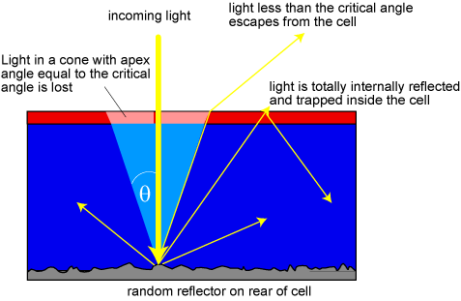
Randomizing surface

Slide 14
Randomizing surface
Textured surface
-creating oblique surface with opposite slopes
-forming grooves at the top surface
-perfectly randomizing surfaces are difficult to realize
-simplest way is to tilt one surface relative to the other
-lower degree of symmetry renders greater degree of light trapping

Slide 15
Practical schemes
Reflective back surfaces
-metalizing the back surface of the cell with Al or Au.
-can be improved by inserting an oxide layer between semiconductor and metal
Front surface texturing
-wet etching
Texturing back surface
-growing the active layer on patterned substrates or gratings

Slide 16
Two important light trapping schemes in commercial solar cells
Laser fired contact
Crystalline Si on glass (CSG)
Thermal oxide layer inserted between the Si device layer and Al metal layer
Passivates the back surface
Enhances Al reflection
Using polycrystalline Si crystallized from amorphous Si as the active layer
Textured glass substrate and a rear reflector

Slide 17
Cell/Module Makers
I thought you may interested in this. ☺
Wafer-based
A-Si thin-film
CdTe thin-film
http://www.miasole.com/www/index.shtml#
CIGS thin-film
CIGS nano-particle

Slide 18
Thank you for your attention!

