Slide 1
High Efficiency Thin Film Solar Cells
Rohit Zijoo & Aditya Purohit

Slide 2
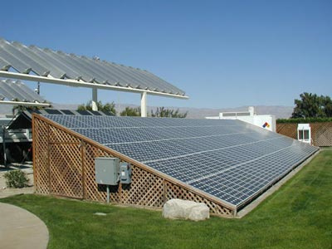
What are Solar cells? A solar cell is a device that converts the energy of sunlight directly into electricity by the photovoltaic effect

Slide 3
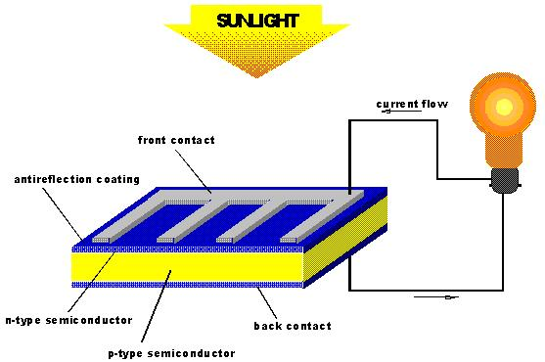
Photovoltaic Effect
The creation of a voltage (or a corresponding electric current) in a material upon exposure to electro magnetic radiation is known as Photo-voltaic effect.
Certain semiconductors materials absorb certain wavelengths
An Example of a semiconductor is crystalline silicon.

Slide 4
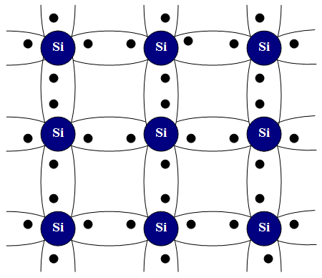
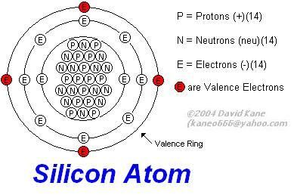
Why Silicon?
Silicon has some special chemical properties, especially in its crystalline form.
An atom of silicon has 14 electrons arranged in 3 different shells.The first two shells, which hold two and eight electrons respectively, are completely full. The outer shell has just 4 electrons. So it tries to fill up its last shell.

Slide 5
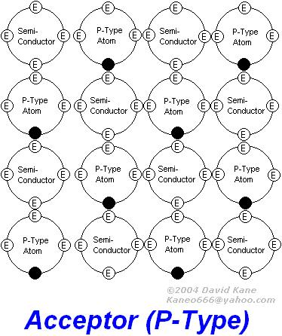
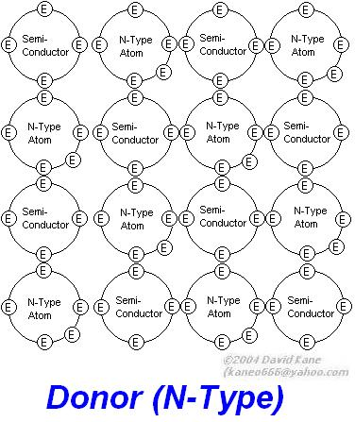
Why Silicon?
Silicon is converted in a semiconductor by doping, eg. Boron or Phosphorus. This is then used to make solar cells.
This process is similar to making computer chips.
This is a cheap material, highly abundant in nature. Thus, a good choice
as compared to other higher priced alternatives.

Slide 6
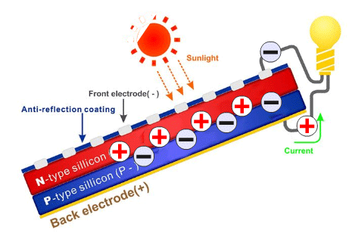
Silicon Solar Cells
A thin semiconductor wafer is specially treated to form an electric field, positive on one side and negative on the other.
When light energy strikes the solar cell, electrons are knocked loose from the atoms in the semiconductor material.
The electrons can be captured in the form of an electric current -- that is, electricity.

Slide 7
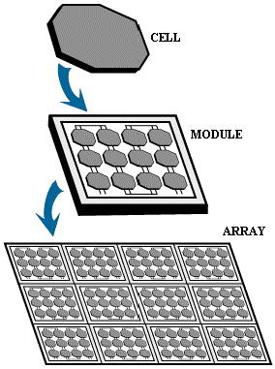
Silicon Solar Cells
A number of solar cells electrically
connected to each other and mounted
in a support structure or frame is called
a photovoltaic module.
The larger the area of a module or
array, the more electricity that will
be produced.
PV cells and modules produce direct
current (DC) electricity.

Slide 8
Different Type Of Solar Cells
While all photovoltaic use similar structure of cells, there
are many different types of cells and panels that can be used.
They vary in their basic materials, ability to produce electricity
and cost.
They Are:
Monocrystalline Silicon Solar Panels
Polycrystalline Silicon Solar Panels
Thin film solar panels

Slide 9
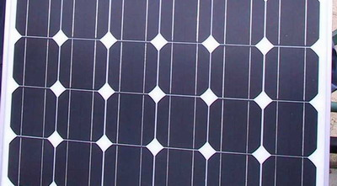
Monocrystalline Silicon Solar Panels
Monocrystalline panels use crystalline silicon, a basic
semiconductor material, they are produced in large sheets.
These are cut in specific size and are used as one large cell
in a panel
They are more expensive but cost effective in the long run.

Slide 10
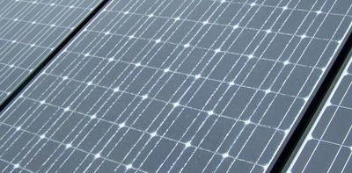
Polycrystalline Silicon Solar Panels
They use a series of cells unlike monocrystalline which
uses one single large cell.
They are the least expensive photovoltaic available today.

Slide 11
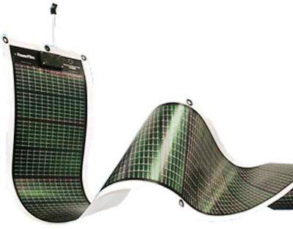
Thin Film Solar Cells
They use an amorphous type of silicon instead of one or
more crystals.
This is much thinner and more flexible than the two
previous types.

Slide 12
Why Thin Film Solar Cells?
Thin film solar most often uses CIGS (copper indium gallium (di)selenide)
technology or amorphous silicon, which are much cheaper and easier to
manufacture than the standard solar crystalline panels we're used to seeing.
Advantages:
Flexible solar is leading the way to cheap energy from the sun.
Costs for this technology are dropping quickly and with the investment
in research and development, these costs will continue to fall.
Unlike traditional panels, flexible panels can be applied to a wide variety of surfaces.
In addition to the traditional roof mounted design, these cells are being molded
to cars, backpacks, clothing, and even windows
Some companies are even integrating the cells into things like roof tiles and siding,
so your house will have solar in it, not just on it.
Thin solar panels have better energy production in different situations such as low
and shading light situations and higher temperatures.

Slide 13
Applications Of Solar Cells.
Solar Cell Plane: Recently made solar cell plane flew Day and Night which was developed by Solar Impulse.
Solar Cell Car: Only using solar power, it is capable of reaching speed of upto 120 km/hr.
Central Heating: Solar Power is used to heat water for home use.

Slide 14
Summary
The recent boom in the demand for photovoltaic modules has created a silicon
supply shortage, providing an opportunity for thin-film photovoltaic modules to
enter the market in significant quantities.
Thin-films have the potential to revolutionise the present cost structure of
photovoltaics by eliminating the use of the expensive silicon wafers that alone
account for above 50% of total module manufacturing cost.

