Slide 1
Solar Cells
Summer research
Presented by:
Peter Eseraigbo

Slide 2
Overview
Introduction
How solar cells work
Products
Challenges

Slide 3
Solar cells
Explorer 6 launched 1959: powered by solar cells

Slide 4
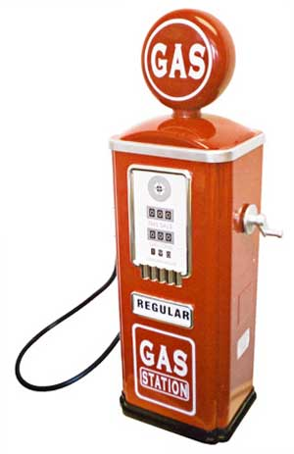
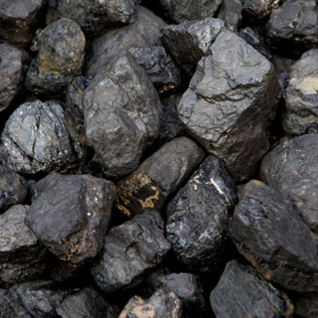
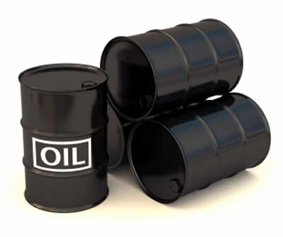
Coal, oil, and gas are not only limited, but also contribute to unpredictable and possibly irreversible climate changes
Coal

Slide 5
On a bright, sunny day, the sun's rays give off approximately 1,000 watts of energy per square meter of the planet's surface

Slide 6
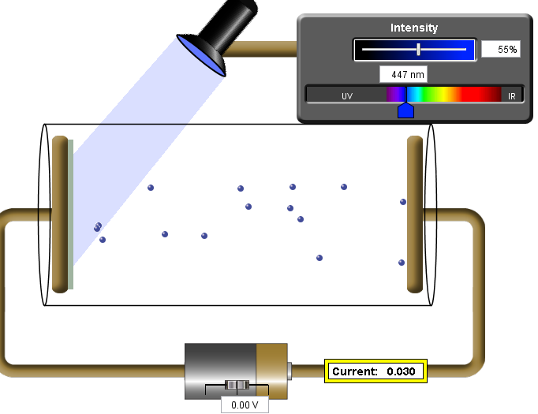
Photoelectric effect: Showed a side of light as packets of energy rather than waves
Increasing frequency of light, produced electric current.

Slide 7
How Solar Cells work
The modern photovoltaic cells / solar cells consist primarily of Silicon.
But ordinary silicon does not help capture and use the photon energy coming from the sun.
We use two other elements that are close in their electronic structure to silicon.

Slide 8
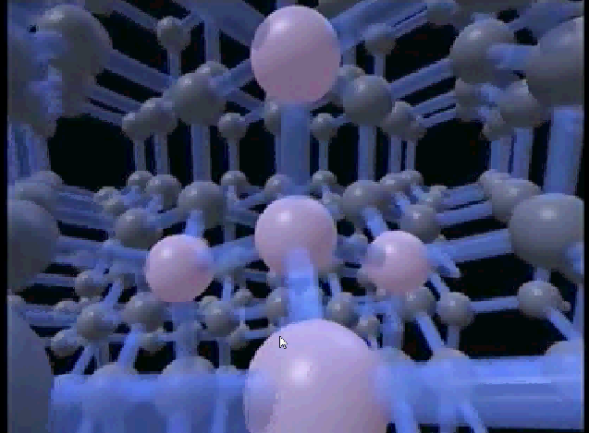
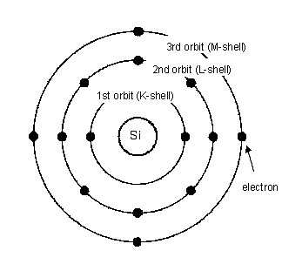
Silicon has 4 valence electrons.

Slide 9
2D representation of the structure of silicon

Slide 10
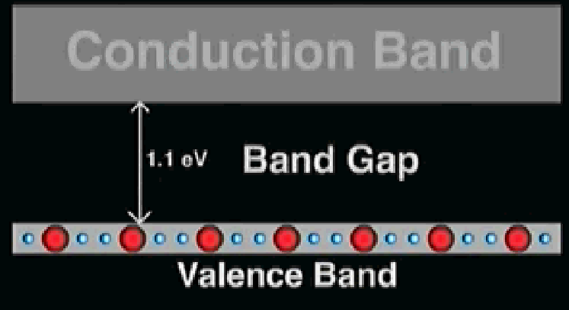
The energy required for an
electron to get promoted to
the conduction band
is the Band Gap

Slide 11
Photons that do not have
the required energy just go
through the material.
Photons that have enough energy
promote electrons to the
Conduction band
Notes:
If a photon of light has sufficient energy, an electron can absorb that energy

Slide 12
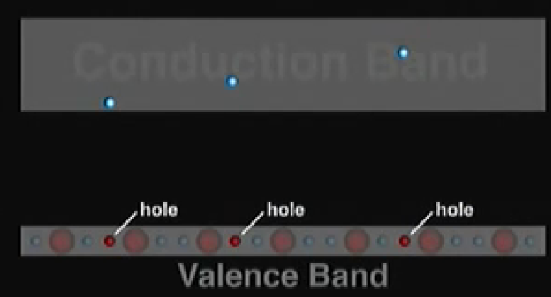
Why do we want electrons in the conduction band?
When electrons are in the conduction band, they are free to move and therefore can carry an electric current.

Slide 13
Recombination
Electrons, once promoted can spontaneously fall back to the valence shell in a process called recombination.

Slide 14
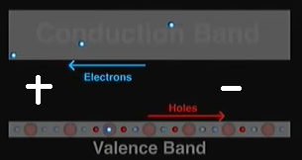
How Solar Cells work
Separating electrons from holes: This can be accomplished with an electric field
Eg. Adding a battery

Slide 15
P-N Junction
We don’t need a battery to create our electric field.
Modern solar cells use an intrinsic electric field to generate the current we need
To do this, a modern solar cell uses a P-N junction.

Slide 16
P-N Junction
Impurities are introduced into the silicon in a process called doping.
In this process, some silicon atoms are replaced with impurity atoms.

Slide 17
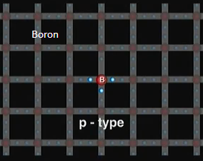
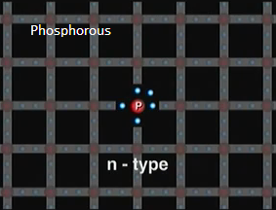
P-N Junction
Boron
Phosphorous
Are common impurity atoms.
Boron forms p-type silicon
Phosphorous forms n-type silicon

Slide 18
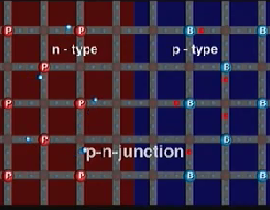
P-N Junction
P-N junction

Slide 19
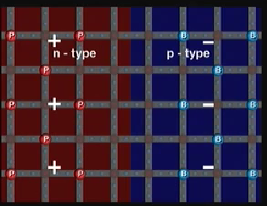
P-N Junction
With the PN junction, we have
prevented the spontaneous
Recombination of the electrons.

Slide 20
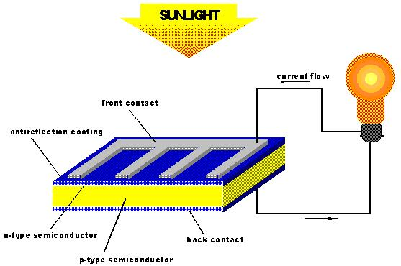

Slide 21
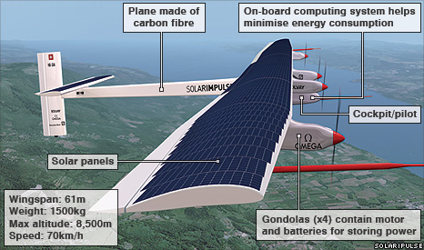
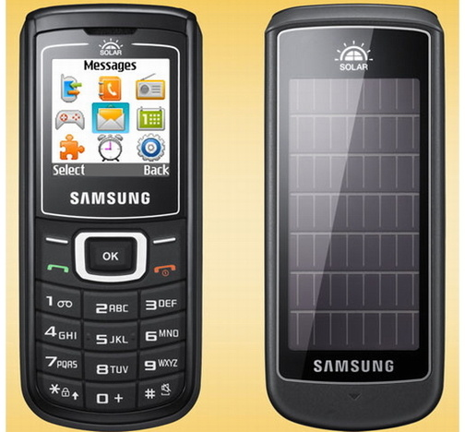
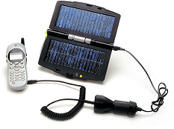
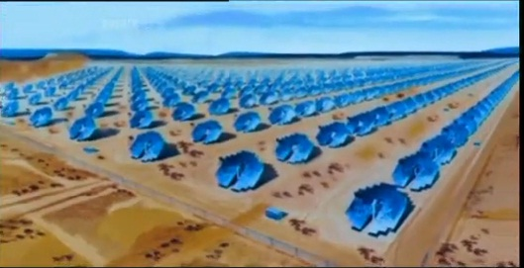
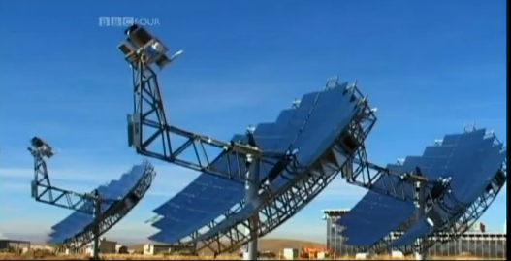
The aircraft uses super-efficient solar cells and batteries to stay in the air after the Sun's rays had faded.

Slide 22
Challenges
Cost
Efficiency
Solar cell technologies
Crystalline Silicon
Thin film solar cell
Amorphous Silicon
Cadmium telluride
Copper Indium gallium diselenide
Dye synthesized solar cell

Slide 23
Efficiency
Loss
electrical
Ohmic
Recombination
optical
-Reflection
-Shadowing
-Unabsorbed Radiation

Slide 24
Cost
Cost of material
Purifying silicon
Energy Storage

