Slide 1
ELEC 1908 QM
Fundamentals of Quantum Theory and wells

Slide 2
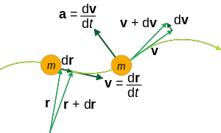
Classical Picture
Matter consists of particles (electron, protons, neutrons). These particles have qualities (mass, charge).
Are distinguishable (we can label them). They have very specific positions, trajectories and predictable actions (deterministic).
They are subject to forces and governed by laws.
Gives rise to equations (usually PDE’s) such as wave, diffusion and Navier-Stokes.

Slide 3
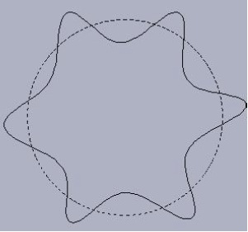
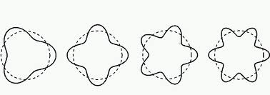
The Start of QM
In 1924 De Broglie proposed that wave-particle duality did not belong to light only and that matter (particles) could also exhibit wave-particle duality.
The famous de Broglie's wavelength relation is:
  λ = h/p = h/mv
Inspired by Einstein’s theory in photoelectric effect i.e. E = hf. He described an electron as a standing wave around the circumference of an atomic orbit

Slide 4
Bohr’s theory
Also at that time, Bohr was working on a planetary model for an atom in which electron-orbits could only have certain discrete quantized energies.
Bohr's second postulate states:
Instead of the infinity of orbits which would be possible in classical mechanics, it is only possible for an electron to move in an orbit for which its orbital angular momentum is an integral multiple of Plank’s constant
From which we obtain:

Slide 5
Bohr + de Broglie
However, using an assumption of electronic standing waves around a nucleus and wavelength relationship we have by combining the two ideas
And we see the two ideas are compatible as h/2π = “h bar”.
We have wave particle duality – as for the photon/EM wave.

Slide 6
Electron wave length
Calculate the de Broglie wavelength of an electron which has a kinetic energy of 4 eV.
Note: The wavelength has the dimensions of inter-atomic spacing.
What’s the de Broglie wavelength of a tennis ball having a mass of 50 g and traveling with a velocity of 200 km/h?
Does this explain why tennis balls don't diffract?

Slide 7
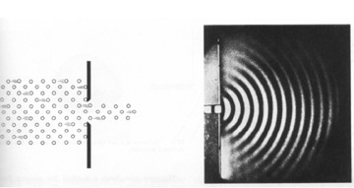
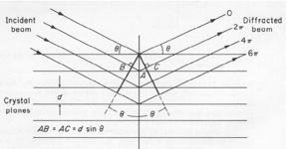

Electrons as waves
If particles have wavelengths we should expect that they should have wave-like behavior.
Diffraction is an easily observed and entirely wave-like effect.
The wave-like behavior of electrons was experimentally confirmed by Davisson and Germer.
Bragg diffraction pattern was produced by electrons with the de Broglie wavelength determining the wave behaviour

Slide 8
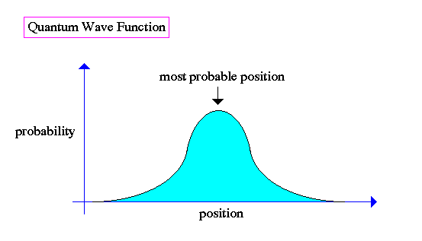
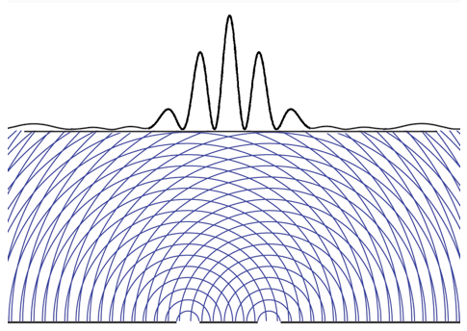
What’s waving?
Quantum mechanics is based on Planck's quantum and De Broglie’s wave-particle duality.
It is a revision of the ``laws of mechanics'' designed to extend the subject into the realm of atomic and nuclear phenomena.
A big question was “what is waving?”.
Well the function that waves is called the wave-function and is denoted ψ - what it “is’’ is difficult.
The wave amplitude is related to the probability of finding a particle in a given region of space or state.

Slide 9
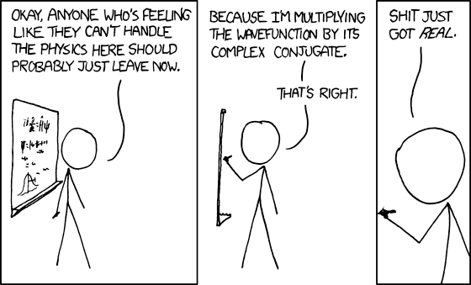
XKCD

Slide 10
Schrodinger’s Equation
An equation was need to solve for ψ and Schrodinger's equation is the fundamental equation of quantum mechanics.
Schrodinger used classical ideas of energy conservation to obtain a likely SCE.
From classical mechanics a function known as the Hamiltonian had been derived which represented the total energy of a system.
P is the momentum operator
We get a wave-like equation
Then assume harmonic in t
Obtain SS equation

Slide 11
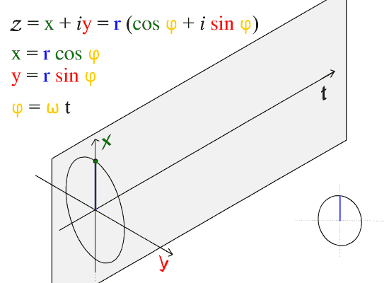
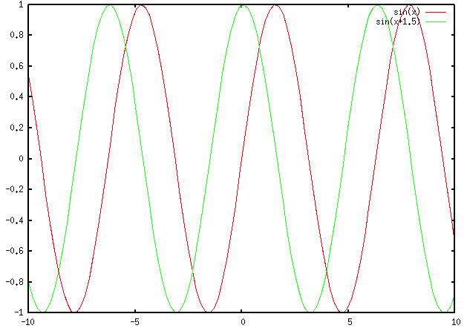
SCE in free space
In free space we have no forces and the potential energy can be defined as:
  V(r) = 0.
For simplicity we assume the 1D case.
Solution is the equation of a traveling wave.
Note velocity is not what we might expect from ½ mv²
Getting the probability of electron being present we have:
Electron is everywhere ??

Slide 12
Interpretation of the Wave-function
The physical interpretation of the wave-function has been problematic since the development of QM.
The difficulties stem from:
  The interpretation of probabilistic nature of the results. The wave-function only tells you the probability of what a system might do not what it does.
  The uncertainty relationship -- the indeterminacy of reality.
  The apparent contradiction of macroscopic (our) reality and the QM description
  Entanglement -- action at a distance.

Slide 13
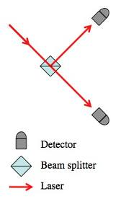
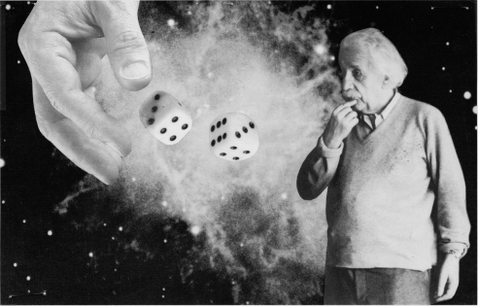
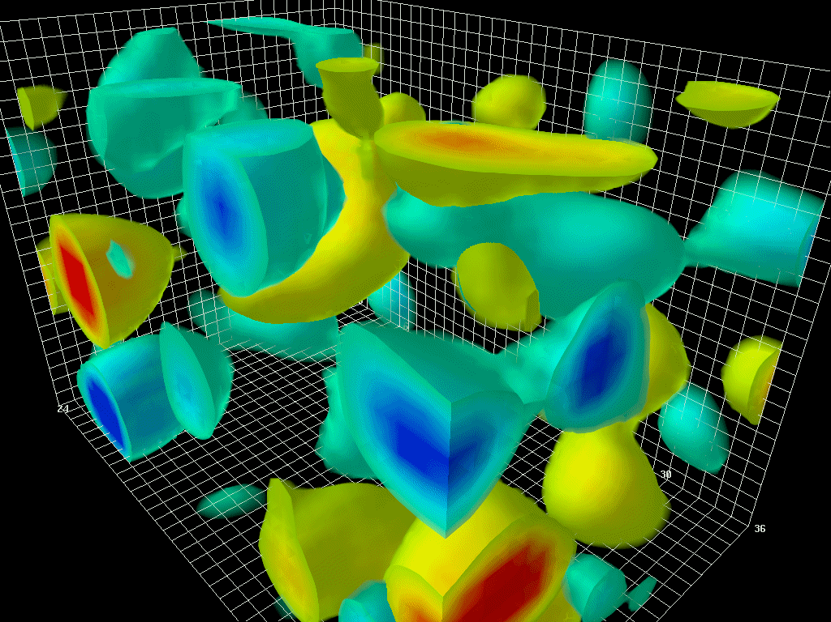
Quantum Randomness
The SCE provides a solution for ψ which is used to predict the probability of outcomes.
For example an electron is scattered off an atom; it has a probability X of going to the right and Y to left.
QM can calculate X and Y but does (and can not) say which it does.
Very disturbing to classical physicists.

Slide 14
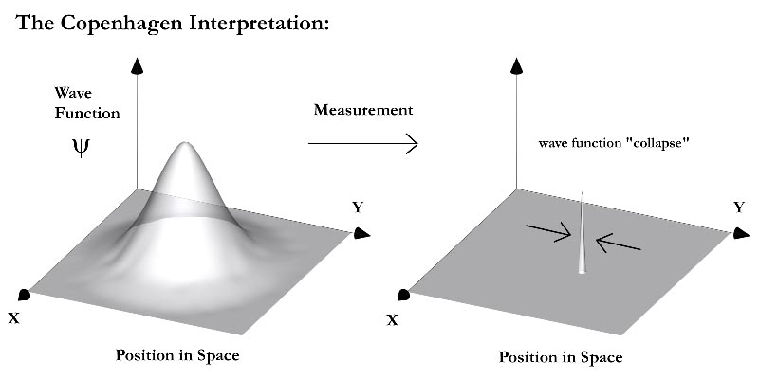
Measurements – “the line between QM and classical”
We can, however, watch an electron scatter using experimental measurements.
What we see is an electron go either to the right or left.
This seems to mean that the wave-function “collapses” to a probability of one and is in a particular state after a system is measured, however, QM has fundamentally no explanation for this phenomena.
This is known as the measurement problem.

Slide 15
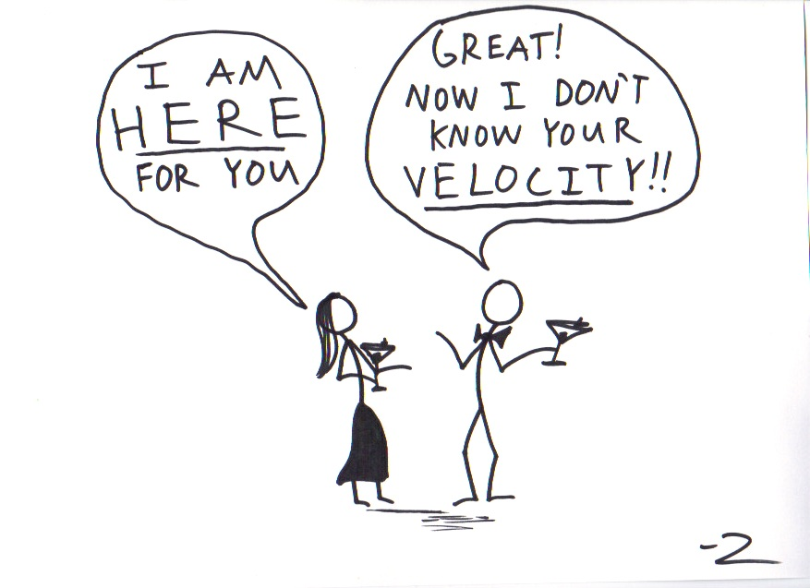
Uncertainty Relation
QM also shows that certain variables, for example position and momentum, are coupled in way that if you try to measure one you disturb the other.
This leads to a limit to our knowledge of the system i.e. an uncertainty in position and momentum.
Mathematically very clear (as we will see) but very un-classical for particles!

Slide 16
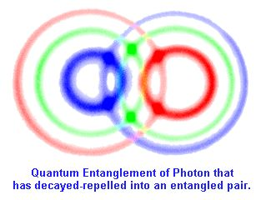
Entanglement
In a QM system of two objects if the objects interact their wave-functions become coupled and inseparable.
Quantum entanglement (non-local connection) is when the quantum states of the constituting objects are linked together so that one object can no longer be described without knowing the state of the other object.
Even if the individual objects become spatially separated they are still coupled!
Photons and electron etc all couple

Slide 17
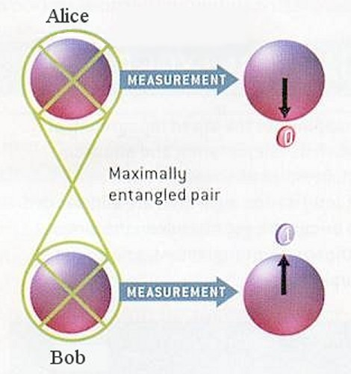
Spin coupling
For example two electrons in close proximity can be coupled so one must be spin up and the other spin down (spin is a quality of an electron).
If the two electrons are then separated and drift apart the net spin must still be zero.
However, QM does not tell you which electron is up and which is down it can only calculate the probability of each electron being spin up or down.

Slide 18
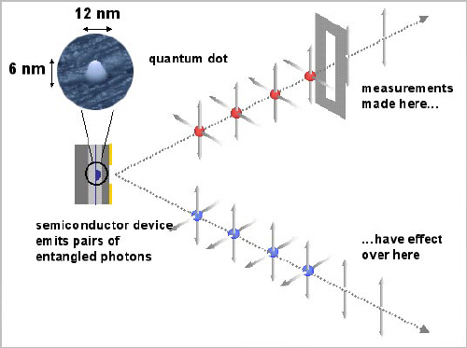
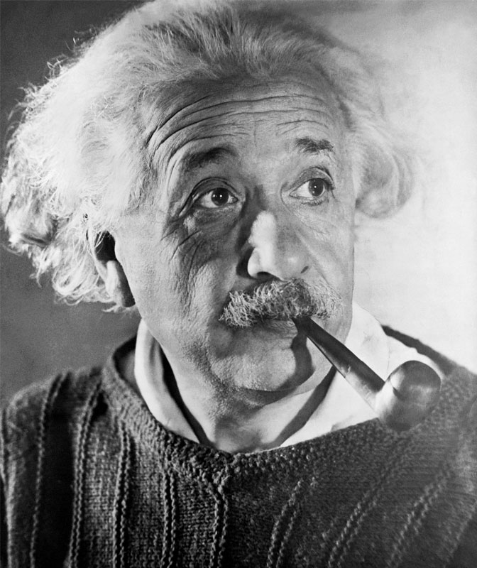
Mixed States
Fundamentally, each electron is both spin up and down at the same time (in a “mixed” state).
When we measure one of the electron's spin and find up we now know that the other must be down as the net spin is zero.
However, the electrons could be separated by light years of distance!
By measuring one electron we forced the other to be the complementary spin -- action at a distance
Not Good! Very strange. Einstein very unhappy.

Slide 19
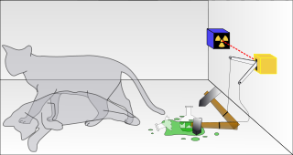
Schrodinger's Cat
A thought experiment was developed in attempt to show the ludicrous nature of QM (by this time Einstein and Schrodinger were beginning to regret the whole idea).
Cat is in mixed state (dead/alive) until we look inside.
At that point the wavefunction “collapses” and the cat is either dead or alive
What/who is an observer (the cat, the Geiger counter, …)
If the cat is decomposing when we look then we know that he died in the past, but he was not either dead or alive until we looked. That means the observer determines the past!
*Partially from: http://en.wikipedia.org/wiki/Schrodingers_cat

Slide 20
Schrodinger's Cat
Schrödinger wrote:
One can even set up quite ridiculous cases. A cat is penned up in a steel chamber, along with the following device (which must be secured against direct interference by the cat): in a Geiger counter, there is a tiny bit of radioactive substance, so small that perhaps in the course of the hour, one of the atoms decays, but also, with equal probability, perhaps none; if it happens, the counter tube discharges, and through a
relay releases a hammer that shatters a small flask of hydrocyanic acid. If one has left this entire system to itself for an hour, one would say that the cat still lives if meanwhile no atom has decayed. The psi-function of the entire system would express this by having in it the living and dead cat (pardon the expression) mixed or smeared out in equal parts.
It is typical of these cases that an indeterminacy originally restricted to the atomic domain becomes transformed into macroscopic indeterminacy, which can then be resolved by direct observation. That prevents us from so naively accepting as valid a "blurred model" for representing reality. In itself, it would not embody anything unclear or contradictory. There is a difference between a shaky or out-of-focus photograph and a snapshot of clouds and fog banks.

Slide 21
Interpretations: Copenhagen -- the classical and original one
In the Copenhagen interpretation of quantum mechanics, a system stops being a superposition of states and becomes either one or the other when an observation takes place.
This experiment makes apparent the fact that the nature of measurement, or observation, is not well-defined in this interpretation.
Some interpret the experiment to mean that while the box is closed, the system simultaneously exists in a superposition of the states "decayed nucleus/dead cat" and "un-decayed nucleus/living cat", and that only when the box is opened and an observation performed does the wave-function collapse into one of the two states.
More intuitively, some feel that the "observation" is taken when a particle from the nucleus hits the detector.
Problem defining observer and observing system -- where to draw the line between macro and microscopic.

Slide 22
Interpretations: Copenhagen -- Many Worlds/Many minds -- Collapse who needs it!
In 1957, Hugh Everett formulated the many-worlds interpretation of quantum mechanics, which does not single out observation as a special process.
In the many-worlds interpretation, both alive and dead states of the cat persist, but are independent of each other.
When the box is opened, that part of the universe containing the observer and cat is split into two separate universes: one containing an observer looking at a box with a dead cat, and one containing an observer looking at a box with a live cat.
Since the dead and alive states are independent, there is no effective communication or interaction between them.
When an observer opens the box, he becomes entangled with the cat, so "observer states" corresponding to the cat's being alive and dead are formed, and each can have no interaction with the other.
Another version has a splitting of the ``mind of the observer'' not the universe.

Slide 23
Interpretations: Many forms of these and others
  Ensemble interpretation, or statistical interpretation
  The Copenhagen interpretation
  Participatory Anthropic Principle (PAP)
  Consistent histories
  Objective collapse theories
  Many worlds
  Many minds
  Stochastic mechanics
  The decoherence approach
  Quantum logic
  The Bohm interpretation
  Transactional interpretation
  Relational quantum mechanics
  Modal interpretations of quantum theory
  Incomplete measurements
For engineers does it matter? Not really just use it. Calculate and move on. Nothing to
see here.
But it is really, really interesting.

Slide 24
Using QM
Electron in well
  Infinite well
  Finite well
  Hydrogen atom

Slide 25
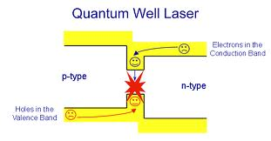
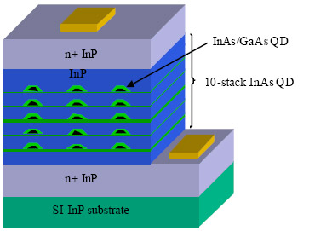
Quantum Wells
Quantum wells are very important
  Materials – electrons in solids
  Devices
    Lasers
    Solar cells
    Quantum dots (biomedical)

Slide 26

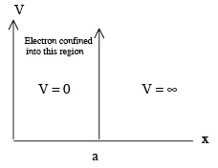



Electron in a box
Infinite potential well
Solve SCE-TI
BC – no electron outside the box ψ = 0
V(x = 0:a) = 0
Define k
Simple wave equation
We can expect modes for solutions
2

Slide 27

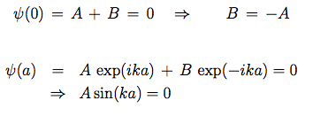
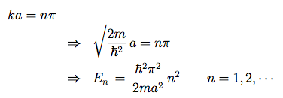

Quantization
2
Use complex exponential wave solution.
Apply BC
  sin solution due to odd solution being needed
  Quantization due to BC
Normalization ensures 1 electron in the box
E missing

Slide 28
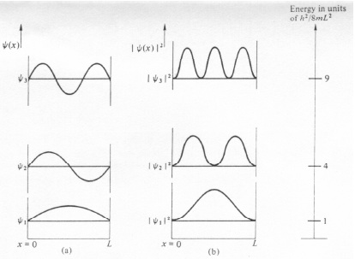

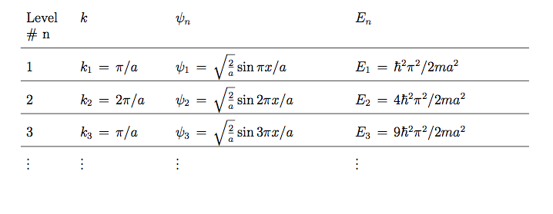
Modes
Set of valid solutions.
Superposition can be used to form wave packet
Non classical behavior

Slide 29
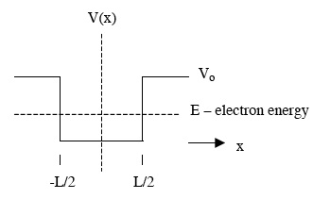
Finite Box
If the box is finite in height then the solution is a little more complex.
Two cases:
  Bound (E < V₀)
  Unbound (E > V₀)
Bound is very similar to infinite box.
Unbound is similar to free electron

Slide 30
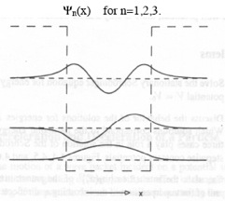
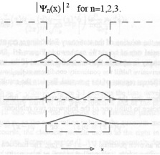
Bound finite well solutions
Very similar to infinite well.
Modes and quantization.
Penetration into the sidewall areas. Very non-classical as
  E < V₀
Maximum E_{n} for which the quantization is maintained.
Again superposition allows for wave-packet from summation of modes. Electron with multiple energies!

Slide 31
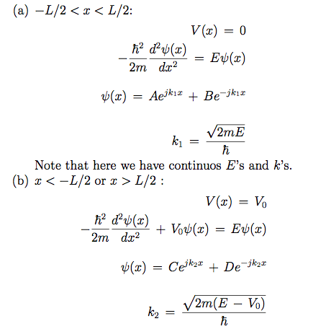
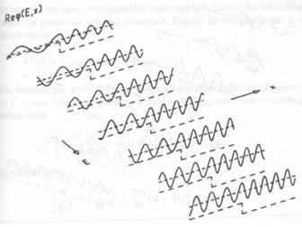
Unbound states E > V₀
Unbound states are purely oscillatory.
Two spatial frequencies k₁ and k₂
Not quantized

Slide 32
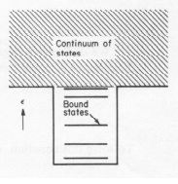
Finite Well – Energy states
Two distinct regimes:
  Bound states:
    E < V₀
    Modes for wave-function
    Quantized energy and momentums
  Unbound states:
    E > V₀
    Travelling wave solution
    Continuous energies and momentums

Slide 33
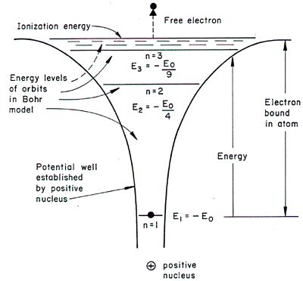
The Hydrogen Atom- Spherical Symmetry
A special and 3D case of the bound electron in a well is an atom.
For an isolated Hydrogen atom, has one electron bounded to its nucleus by coulomb force

Slide 34
The Hydrogen Atom- Spherical Symmetry
Using Schrodinger’s equation we can analytically find the eigen-states for the Hydrogen atom.

Slide 35
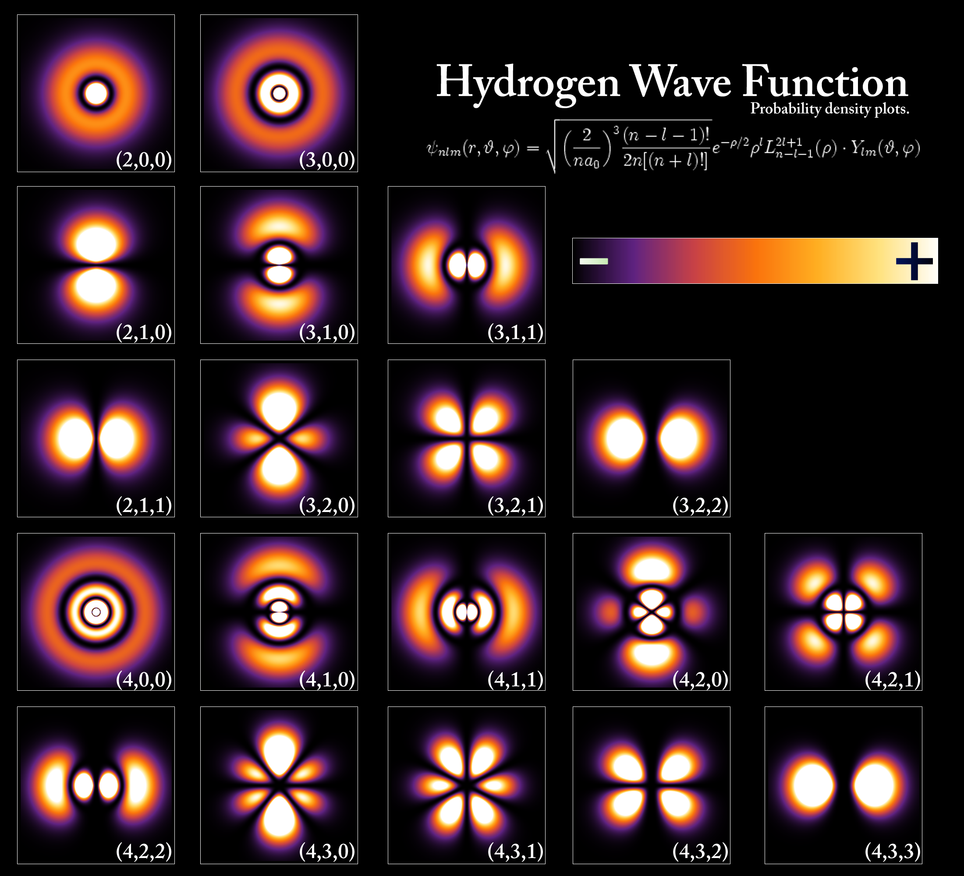
The Hydrogen Atom- Spherical Symmetry
Examples of the wave-functions that describe the chemical states (orbitals)

Slide 36
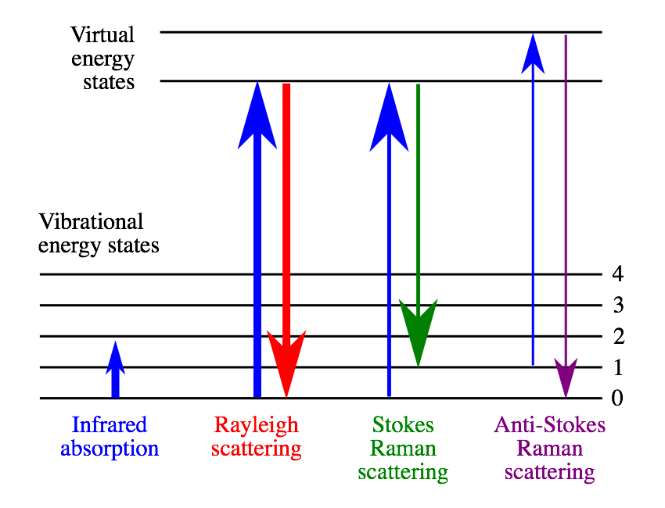
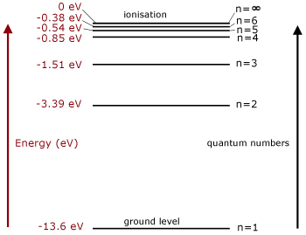
Implications of Quantization
Because of the fact that the electron of an isolated atom can assume only certain energy levels, it follows that the energies which are excited or absorbed also posses only discrete values.
The discrete E's produce spectral lines

Slide 37
Applications of Quantization
Semiconductor materials and devices
Photonics, Lasers
Memory storage by storing information as excited states in molecules
Input/Output signals using excitation and stimulated emission
Quantum Computers. Use photons to switch states.

