Slide 1
ELEC4601 Microprocessor systems
Lab 4 Tutorial
USART and Floating point

Slide 2
Lab # 4
Part A
8251A (USART) and 8279 (LED Display)
Part B
8087 Emulator – Floating Point Multiplication

Slide 3
Suggested Readings
Lab Manual: Lab # 4
SDK-86 User’s Guide: Serial Interface (Section 2.11)
Peripherals Handbook: 8251A, 8279, 8087
8086 User Manual: 8087 operation (Chap. 3)
Online: IEEE 80-bit extended format for floating point

Slide 4
USART and display
PART A

Slide 5
Part A: Objectives
Use of USART (Universal Synchronous/Asynchronous Receive Transmitter) - 8251A
On SDK board, 8251A is used to communicate with PC (“GO FE00:0.”)
SDK board keypad controller – 8279
8279 controls the SDK-86 board’s keypad and display interface
Given: SDK2PC subroutine
Receives characters typed in on SDK keypad and transmits them to PC
Write: PC2SDK subroutine
Characters typed on PC will be shown on the SDK-86 display

Slide 6
Part A: PRELAB
Complete PC2SDK subroutine in lab4a.asm
Hints (see pseudo-code in Lab4a.asm):
Use RxRDY_MASK to see if the USART receiver is ready (received any data)
How to read the data in from USART? (IN command)
Incoming data is in ASCII; use ASCII ranges to filter unwanted data (characters that can not be displayed in the 7-segment display)
Use the LED table (XLAT) for translation (7-segment)
To handle unwanted data, show “.”

Slide 7
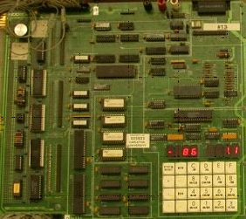
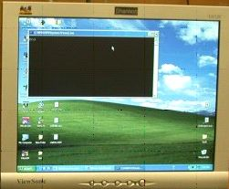
How these procedures are evoked?
PC2SDK
PC2SDK
SDK2PC
SDK2PC
LED_TABLE is given (contains 0-9, A-F & .)
You will need an ASCII code table (next page)
Your code PC2SDK should do followings:
If a number (0-9) is pressed in PC, show it in SDK
If a character among A-F is pressed, show it in SDK
If anything else is pressed, show “.” in SDK
Nothing is pressed, no change (exit procedure)

Slide 8
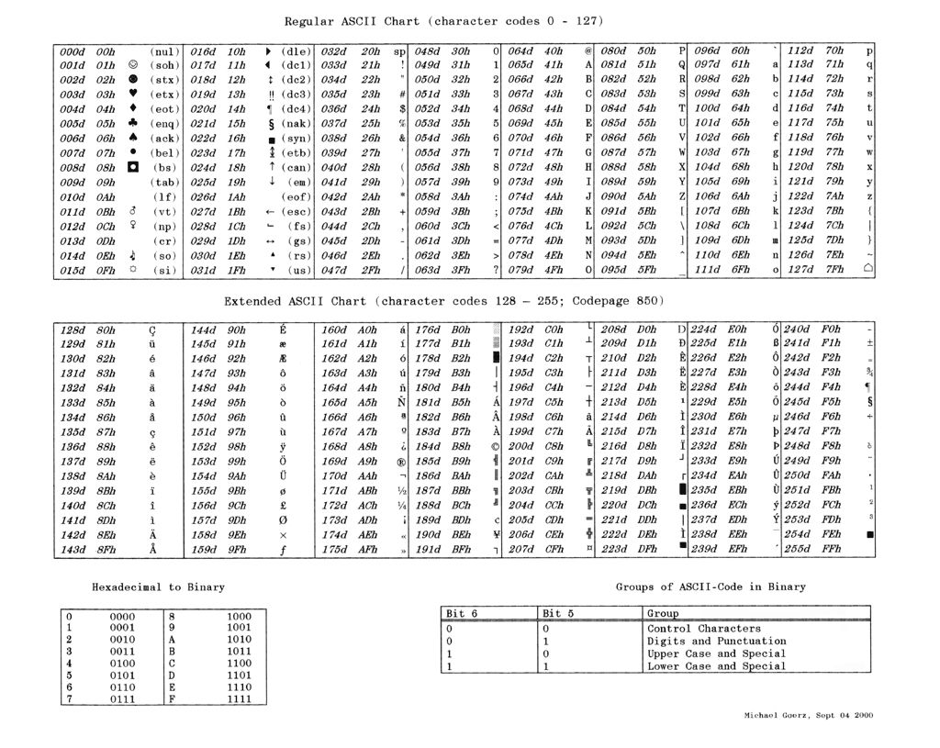

Slide 9
Part A: Procedure
Complete modifications to lab4a.asm
Write PC2SDK subroutine (follow pseudo-code)
Note: Characters received from the PC are in ASCII and must be translated into the 7-segment format for the SDK display. Lab4a.asm already contains the translation table
Hint: Use conditional jumping according to ranges of ASCII code of incoming data
Use the mode and control bytes needed to program the 8279 and the 8251A
Run the program and demo it to the TA

Slide 10
Floating point operation
PART B

Slide 11
Part C: Objectives
Lab4c.asm contains a floating point multiplication routine that emulates the 8087
The floating point numbers are stored in IEEE 80-bit format:
sign-bit + 15-bit exponent + 64-bit mantissa
The multiplication algorithm handles the exponent and fractional parts of the floating point numbers separately.
It treats the fraction part (64-bit mantissa) as four 16 bit words, multiplying each word in the multiplicand by each word in the multiplier.
The final exponent (15-bit) result is simply the addition of the two input exponents with some adjustment for normalization.

Slide 12
IEEE 80-bit extended format
sign-bit + 15-bit exponent + 64-bit mantissa
The numbers are normalized to the following format, where e is the exponent and X is the mantissa:
(−1)^{s} ∗ X ∗ 2 ^{e}
If S = 0, +ve If S = 1, -ve
Mantissa (X) is in fraction format:
X₆₃*2⁰ + X₆₂*2⁻¹ + X₆₁*2⁻² + X₆₀*2⁻³ + X₅₉*2⁻⁴ …+ X_{63-i}*2^{-i} +…
Actual exponent (e) is in Excess-N biasing format:
e = Exponent – (2¹⁴ – 1)

Slide 13
Part C: PRELAB
Review the code for lab4b.asm
Bring a stopwatch for timing the programs
Review extended precision IEEE floating point standard
Consult online references
Google for IEEE floating point format (80-bit) and how to decode it
http://www.opferman.net/Text/ieee.txt

Slide 14
Part C Procedure
Use “MASM LAB4B.ASM /r”, “LINK LAB4B.OBJ”, “LAB4B.EXE”
DO NOT use ASSEM
The result of the multiplication is displayed on the screen in 80-bit format. Convert into mantissa/exponent format and find the value
You have to adjust the loop variables COUNT and COUNTA to get good execution times
How are COUNT and COUNTA related?
Find the difference in execution times between the 8087 and the emulator (show to a TA)
Discuss the difference between the two results

Slide 15
See you next week!

