Slide 1
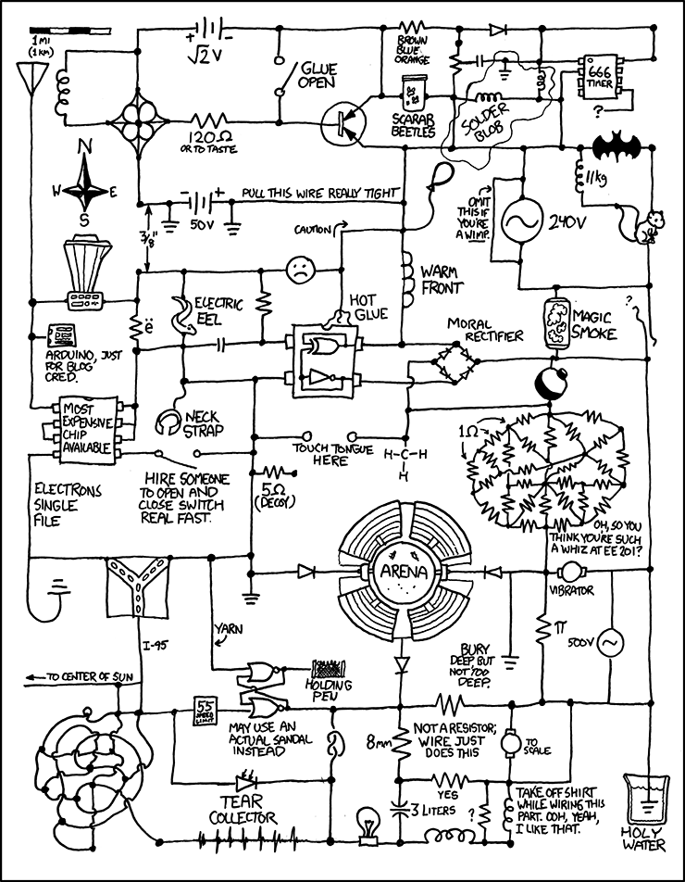
ELEC 3509 Fall 2014 Lab Orientation
Course Information
Lab Information
Guidelines
Schedule
Expectations
Pre-Labs
Lab Reports
Mark Disputes
Tips & Tricks
http://imgs.xkcd.com/comics/circuit_diagram.png

Slide 2
ELEC 3509 – Fall 2014
Norman Fong (head TA)
3303 Canal Building
nofong@doe.carleton.ca
Course website
http://www.doe.carleton.ca/~jrogers
Course Notes + Lab manual
Lab website
http://www.doe.carleton.ca/~nofong/ELEC3509
Lab guidelines (important!)
Marking schemes
Check this website at least once before each lab
Lab content
Design, simulation, building and testing of analog circuits and devices
Labs start Tuesday September 23rd

Slide 3
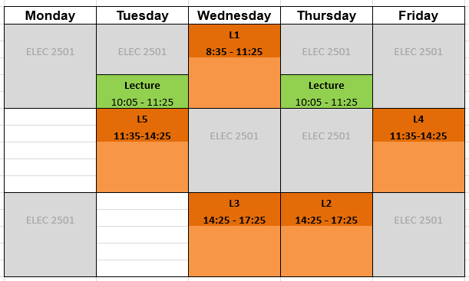
Lab Schedule
Room: 4195 Mackenzie
You must attend your registered section
Show up on time!
TAs have been instructed to not stay later than the assigned lab hours
You can also work on your own anytime the lab is open
Due to the high enrollment in both this course and ELEC 2501, it is unlikely that there will be extra space during another section so those students will be given priority.

Slide 4
Lab Guidelines
Labs are every week and performed in groups of 2
Worth 30% of your final mark
You MUST pass the lab in order to pass the course
One report is to be submitted per group. Both students will receive the same mark.
You MUST hand in a satisfactory report for every lab
You cannot submit an unfinished report (missing large portions, no results etc.)
Every lab will have a marked prelab
Marked on an all-or-nothing basis
Every lab will have a marked checkout
Your lab must be complete on time and in your designated lab section
It is your responsibility to be done on time
If you are knowingly going to miss a lab contact your TA prior to the lab
We can arrange an alternate lab day for you to attend without lateness penalty
Missed labs due to illness will require a doctor’s note.

Slide 5
Plagiarism
Zero tolerance!
Automatic mark of zero for all parties
Report to the Professor and sent to the Dean
http://www1.carleton.ca/studentaffairs/academic-integrity/
Last year (2013 Fall) we had 30 (!!!) students with suspicious reports for Lab 2
Most of these reports were sent to the Dean
What constitutes plagiarism?
Copying any content (text, figures, tables, data) from any source
This includes your own work from previous years
Failing to acknowledge sources through citations

Slide 6
Lab Expectations
Read over the lab before showing up
Walk through the lab and understand what you are going to be doing
E-mail a TA to ask a question of something is unclear
Pro tip: If possible, pre-assemble your circuits and setup Excel or Matlab files
Complete the pre-lab before entering
Be able to debug your circuits on your own before calling a TA
Manage your time effectively
Clean up your station after you are done

Slide 7
Pre-labs
Every lab has a marked prelab, including Lab 1!
The pre-labs are all extensive and typically include all of your design calculations
You won’t be able to do the labs without them!
Treat them like you would an assignment
Pre-labs for labs 2,3 and 4 can take several hours (more likely days) to complete.
Prelabs will be checked at the beginning of the lab (first 30 mins)
We will ask you technical questions about the pre-lab to verify that it was not simply copied from someone else.
Marks are all or nothing
If your prelab is not ready at the start of the lab, TAs will not help you complete it during the lab.

Slide 8
Lab Kits
The lab manager will distribute lab kits which include:
A breadboard and all the components you will need for these labs
One kit is required per group at a cost of $15
If you already have your own equipment then you can use that instead.

Slide 9
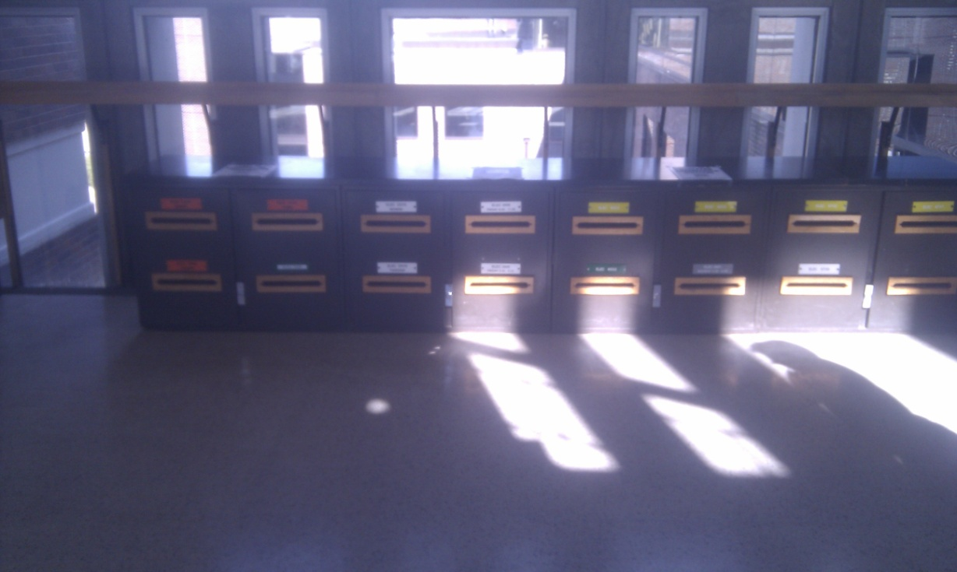
Lab Reports
Reports are due one week after the lab has been completed
They are due 30 minutes after the beginning of your lab session
Drop off in stairwell drop boxes outside 41xxME.
Late reports will lose 25% immediately and 10% PER DAY after.
If you are knowingly submitting your lab late, contact Norm immediately and an electronic submission may be accepted.
It is ultimately YOUR responsibility to have your lab in on time.

Slide 10
How to Write a “Good” Lab Report
There is no specified format, however it should be logically organized and written in a professional manner
The following is an example of how you could organize a design report:
Introduction
Explain what you are doing and how you will be doing it
Specifications
Explain the design specifications of the lab.
Design
Organize the calculations from your pre-lab and explain your design.
This is incredibly important. Just showing equations is not sufficient. You must explain what you are doing with these equations as well as the results.
Testing/Results
Explain how the circuit was implemented.
Explain the order in which measurements were taken and show the results
Explain conclusions derived from these results
Compare results to predicted results
Summary
Summarize key results and provide a conclusion
References
Reference materials or figures properly
IEEE citation format: http://www.ieee.org/documents/ieeecitationref.pdf

Slide 11
How to Write a “Good” Lab Report
Your lab report should:
Be thorough and concise
Be readable without having prior knowledge of the lab
Describe what you did and how you did it
Explain and discuss the results
Have all figures and plots labelled with appropriate units
Cover everything in the marking scheme
Prove that you did the work and understood it.
You will not be given the benefit of the doubt if your report is vague or unclear
Stay in contact with your lab partner to make sure everything is done on time

Slide 12
Common Lab Report Mistakes
Failing to verify that all marking scheme requirements are addressed in the body of the report
Failing to re-develop the design equations in the body of the report
Just attaching the pre-lab as an appendix is insufficient, you must use an equation editor to include the design equations in the body of your report
Failing to refer to figures and tables in the text of the report
Failing to compare expected and observed results & propose explanations for the variation
Failing to check for spelling and grammar errors before submitting

Slide 13
Mark Disputes
Lab Report Returns
We will try to return your labs 1 week after they are submitted
Mark Disputes
If you wish to dispute a mark, you must do the following
Wait 24 hours and review the marking scheme for the lab
Send the marking TA e-mail with an explanation as to why you think you deserve a different mark.
If this cannot be resolved then you should request a meeting
TAs are instructed to NOT give out additional marks just because a student complains. Justification is required.
TAs will not adjust your mark in lab (so don’t ask)

Slide 14
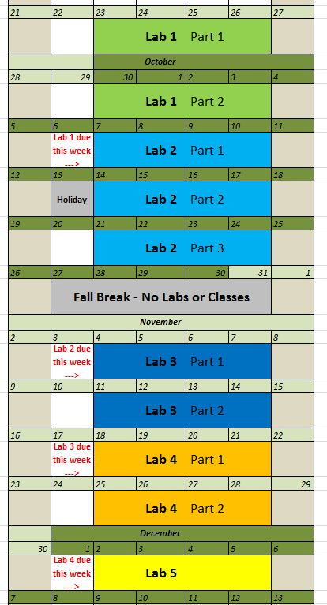
Lab Calendar
Lab 1: BJT DC and AC Characteristics (2 weeks)
Lab 2: Two transistor amplifier project (3 weeks)
Lab 3: 741-Op Amp (2 weeks)
Lab 4: Active bandpass filter (2 weeks)
Lab 5: Oscillator (1 week, no report)

Slide 15
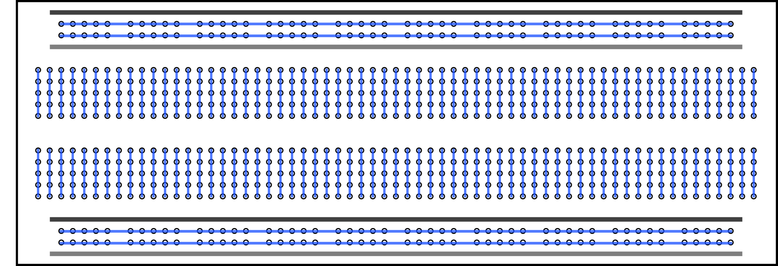
Lab Tips: Breadboard
Lab kits will be distributed during the first lab
Breadboard, components, etc.
Find a convenient carrying case
Familiarize yourself with the breadboard
Utilize the upper and lower “rails” for your power supplies

Slide 16
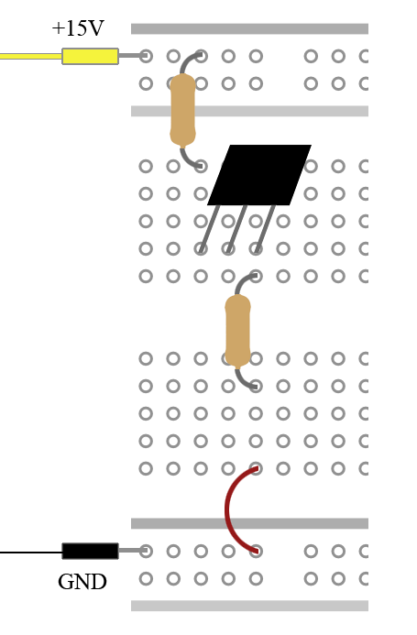
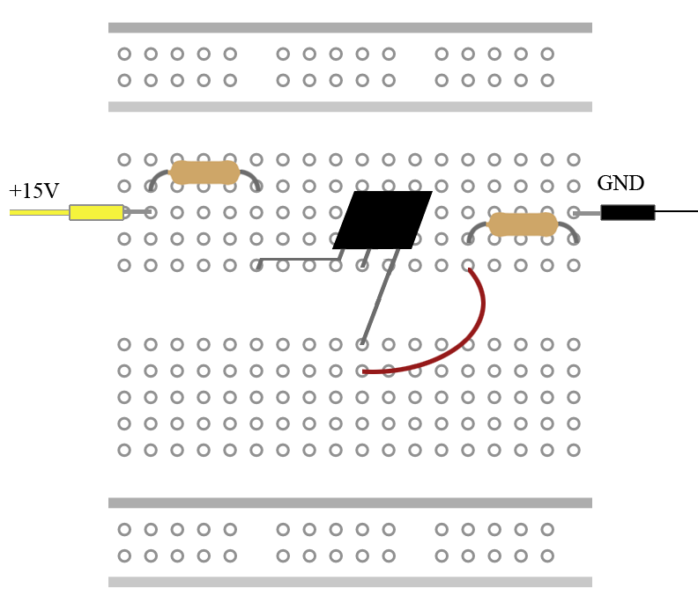
Lab Tips: Power Rails
VCC=15V
Good idea
Bad Idea

Slide 17
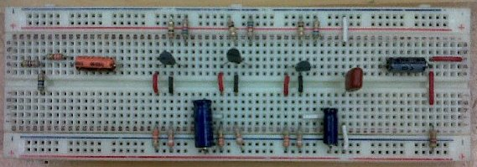
Lab Tips: Circuit Layout
Try to lay out your devices to match the circuit diagram.
Intelligently place your transistors, resistors and chips.
Use short jumper cables instead of stretching out the pins on your device.
+
-

Slide 18
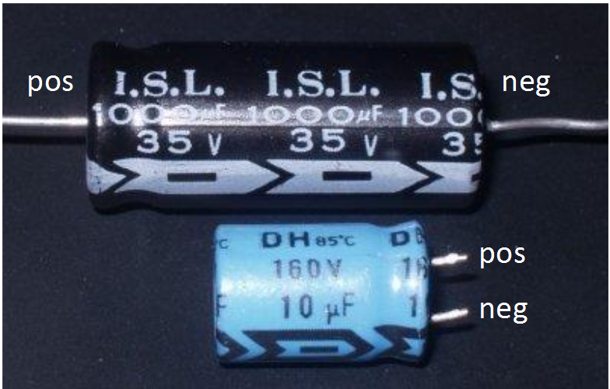
Lab Tips: Electrolytic Capacitors
Electrolytic capacitors are directional
Ensure polarity is properly aligned in your circuit
They can blow up if placed improperly
The arrow points in the direction of current flow (i.e. The negative terminal)

Slide 19
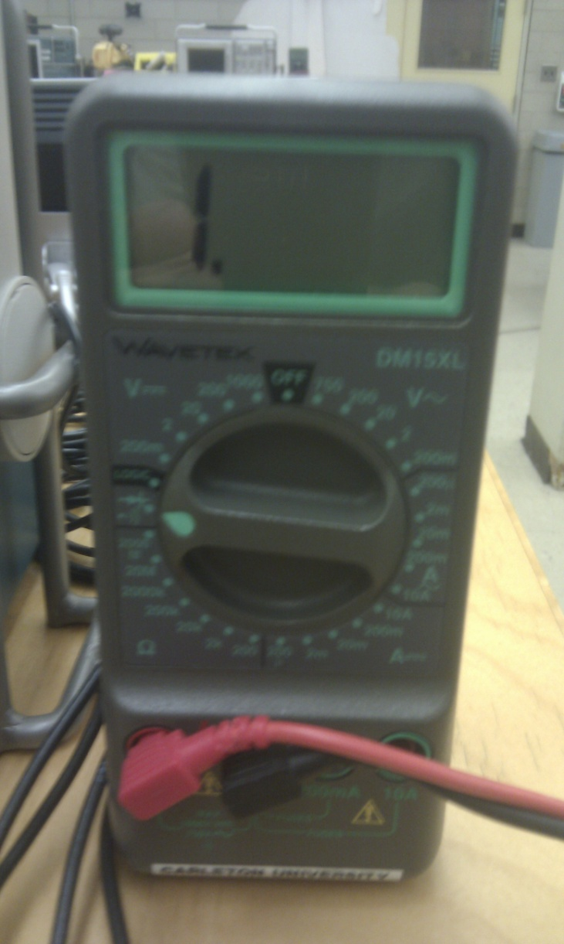
Lab Tips: Multi-meter
DO THIS
Measure all of your resistors (Ω)
Measure DC Voltages
Use Ohm’s Law to calculate DC current from a measured voltage
Use “Diode Mode” range to measure diodes
NOT THIS
Do NOT Measure current
Do NOT measure AC voltages/currents
Unless instructed otherwise
The Oscilloscope is always more accurate

Slide 20
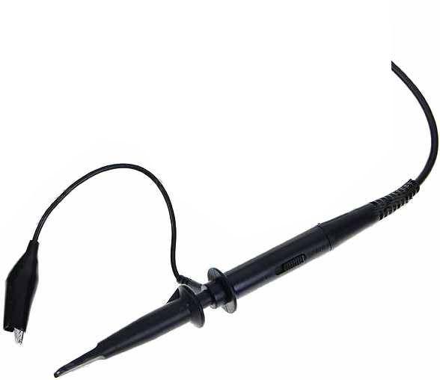
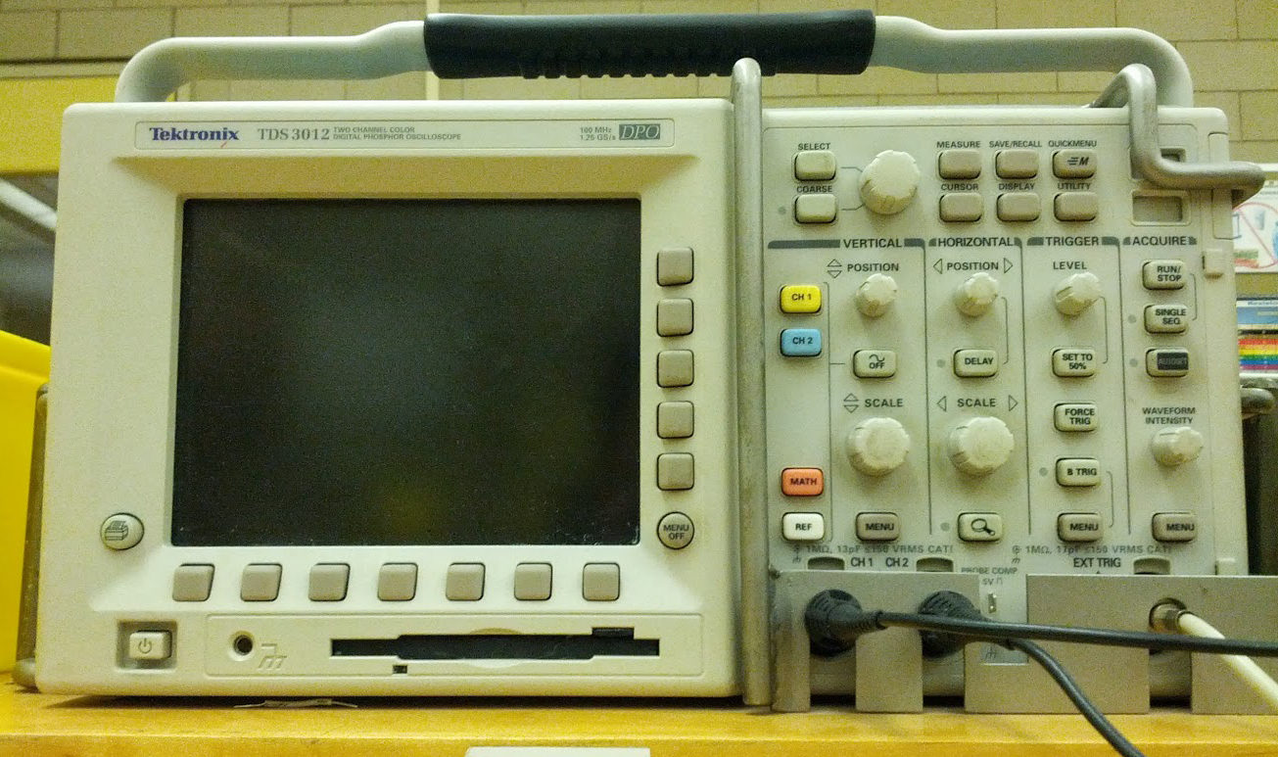
Lab Tips: Oscilloscope
Ground
Probe tip
The probe does not have positive or negative terminals
Ground must always be connected to ground
“Autoset” is not your friend!
Can be used to initially capture a signal but if you press it again it will reset all of your settings
Measure peak-to-peak voltages using the cursors
Do not trust the digital “measure” function, especially if the signal is noisy
Cursor Buttons
Autoset – Resist the urge to spam this button

Slide 21
Tips & Tricks: Equation Editors
Use an Equation Editor so that the TAs can read your work
Hand-written pre-labs attached at the end of the report are not acceptable!
MS Word 2010 has a built-in equation editor (see below)
Other equation editors you might consider are:
Maple (on DOE computers)
LaTex (online)
Pro Tip: How to find the Equation Editor in MS Word 2010

Slide 22
END

Slide 23
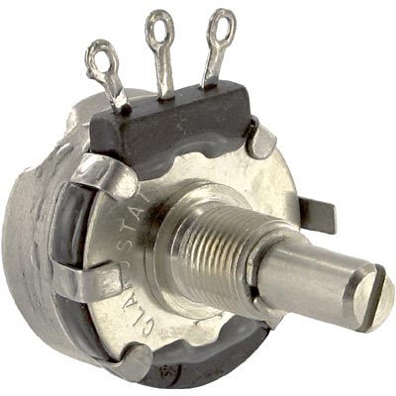
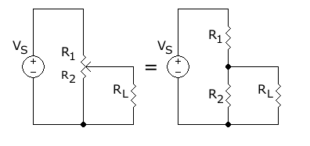
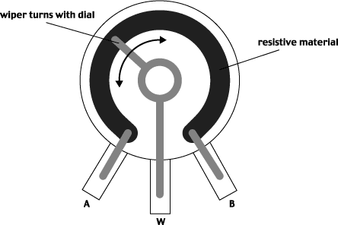
Lab Tips
A potentiometer is a 3 terminal variable resistor which acts as a voltage divider.
You do not need to add another 1kΩ resistor to your circuit. The potentiometer is the resistor.

