Slide 1
Coffee with a Prof
Tom Smy
Eng. Physics Coordinator

Slide 2
Outline
A bit about me
Undergraduate Courses
  1908
  4700
Graduate Studies and Research
  Research with me – modeling and simulation
    What I’ve done – Materials, nanostructures and fabrication
    What I’m doing – Thermal modeling, simulation techniques and optical circuit simulation, meta surface modeling (EM)
More about me

Slide 3
Me, Myself and I
Born in Vancouver, grew up in Edmonton
Education
  B.Eng (86’, UofA, Edmonton) – EE and what you would call a minors in physics and computing
  Ph.D (90’, UofA) EE – Modeling and characterization of a semiconductor magnetic sensor.
During my Ph.D also worked on simulation of material deposition modeling.
1990 Moved to Ottawa to become Prof at Carleton.
Consulting at Nortel and work with Optiwave. Inc. + others

Slide 4
Carleton
Courses in devices, physics and technology
Research primarily in material modeling for IC interconnect fabrication and reliability
Sabbatical at Nortel lead to research in thermal modeling of devices, chips and systems
7 years ago moved into modeling optical/electronic devices and circuits.
Recently started work on fundamental EM modeling of meta-surfaces.
Helped create Eng. Phys. at Carleton in 199? and have administered it since then.
  1st year 3 students, currently 30 incoming!

Slide 5
Undergraduate course – 1908
I think you know all about this!
For those who don’t it’s a useful version of ECOR 1010

Slide 6
ELEC 4700 – Winter term!
ELEC 4700 -- The Physics and Modeling of Advanced Devices and Technologies
  The course deals with the fabrication, operation and modeling of advanced devices for information technology. Topics: physics of materials, quantum mechanics of solids, optical transitions, physical analysis and models for state-of-the-art electronic/optical technologies and materials. Technologies: MOS and III-V based transistors, solid-state optical devices, MEMS and nano-technology based devices.

Slide 7
4700 – Winter term!
Course in on “modeling” of physical systems/devices
Very broad scope
  Atoms and Kinetic theory
  Quantum Mechanics (electrons and materials)
  Semiconductors (materials and devices)
  Circuit modeling
  Device modeling (lasers, bjt, etc)
Three basic modeling topics
  Molecular Dynamics, Monte-Carlo (stochastic, agent based)
  Numerical differential equation solvers (finite difference)
  Compact modeling (device models for simulators)
Emphasis on Matlab implementation of models

Slide 8
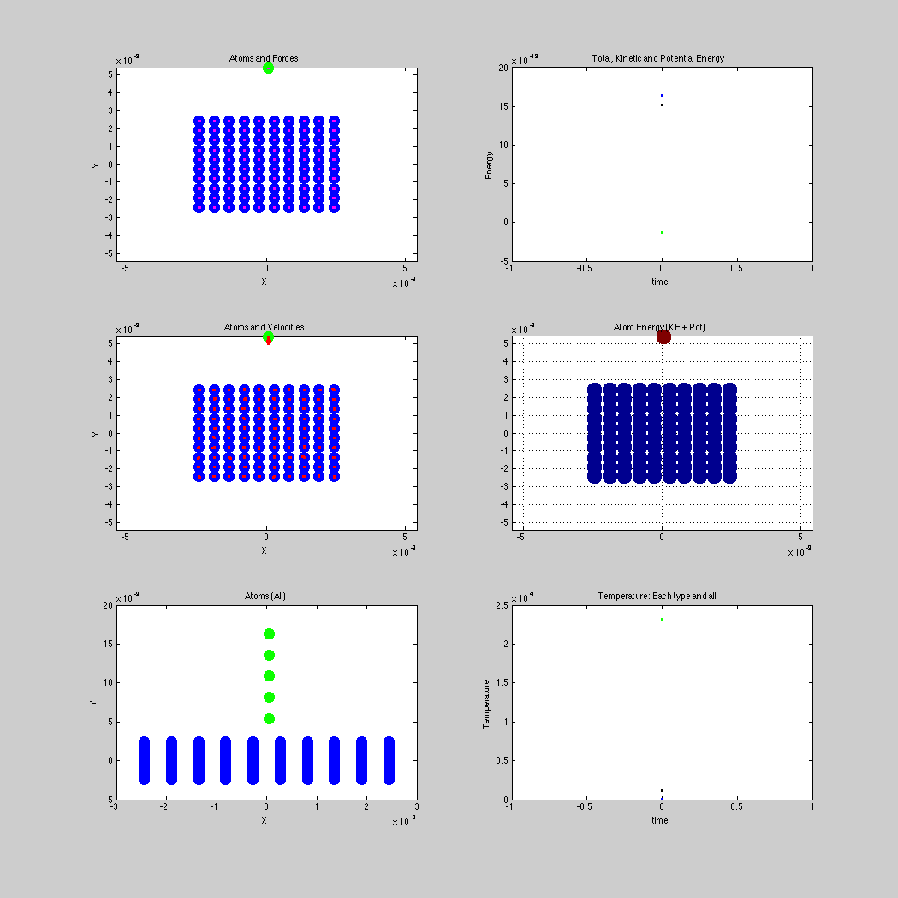
4700 – Molecular dynamics modeling
Example of a Block bombarded by 5 heavy atoms.
Solve Newton’s equation for a molecular system
Masses 12 and 100
Heavy atom transfers both energy and momentum to block of atoms

Slide 9
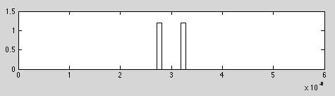



4700 – differential equations
SCE Time Dependent Modeling

Slide 10
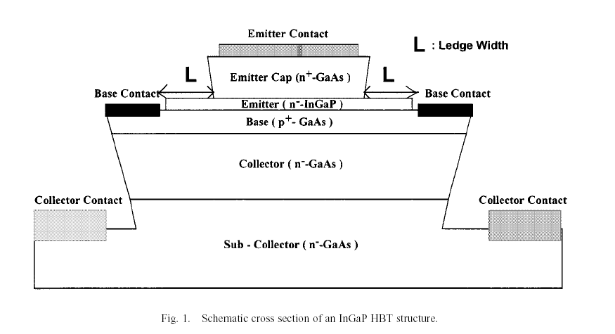
4700 – Compact models and devices
Models to stick in circuit simulators
  BJT’s, HBT’s, Mosfets, etc
  Lasers, optical devices
Build small compact physics based models

Slide 11
Research – the past
Monte-Carlo based material modeling
  Full 3d
  Lots of physics
    Flux transport
    Surface physics
  Post-deposition analysis
    Density/microstructure
    Heat flow
    Conduction
Applications
  On chip interconnects
  Nano structured films

Slide 12
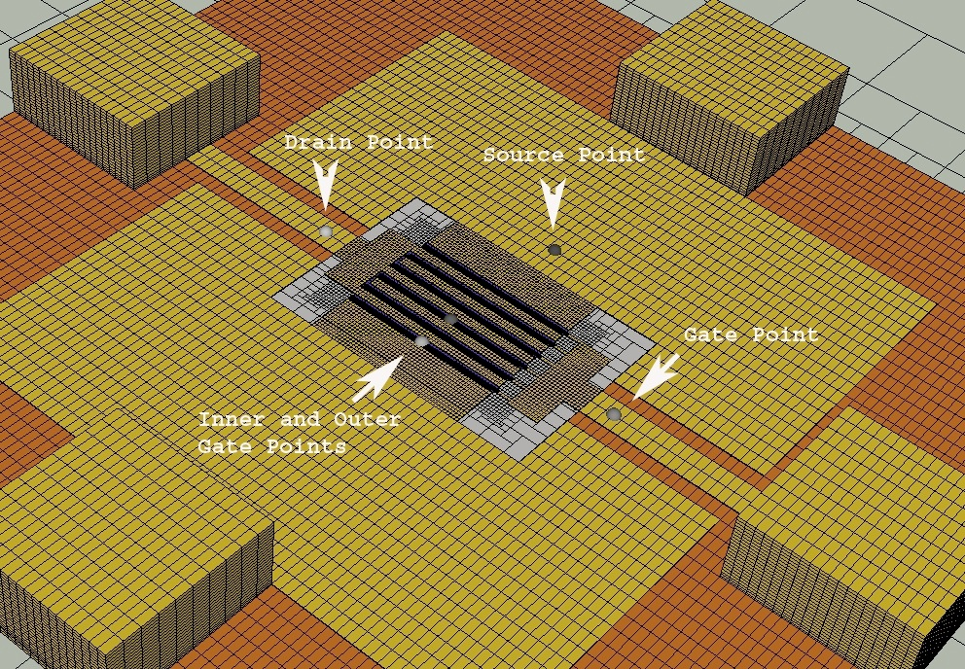
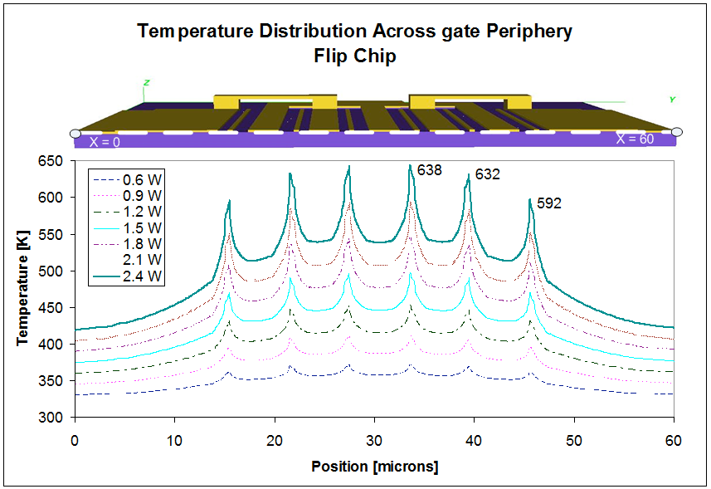
Research the present -- Atar
Mature 3D meshing and non-linear thermal solver
    Based on FDTD with a non-uniform meshing
    Builds from layout and geometric information.
    Mature effort in building very accurate small thermal macro models.
    OptiSPICE (described later) has a “matrix element” (general non-linear model) that can use these macro-models

Slide 13
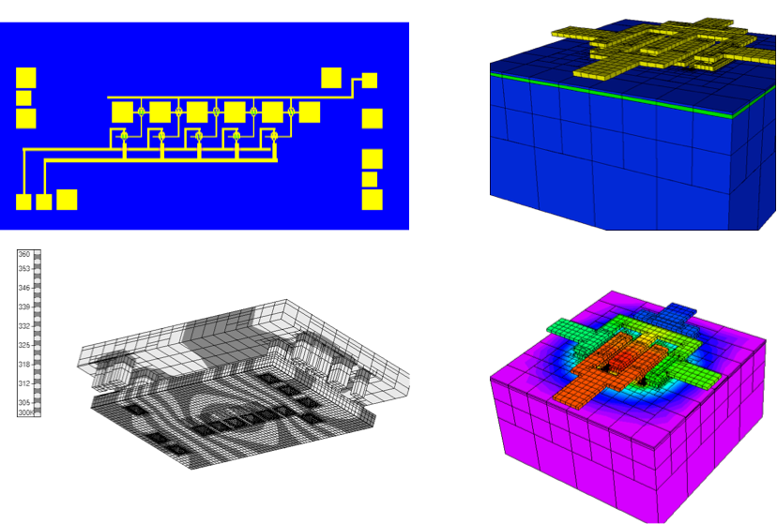
Atar model - electro-optical module

Slide 14
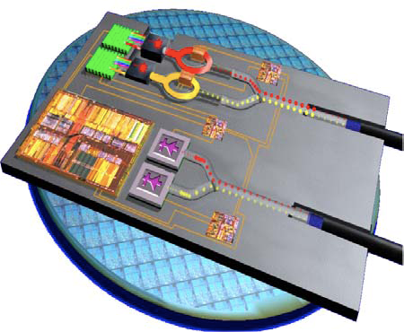
Optical Circuit Simulation: OptiSPICE
Developed with local company OptiWave Inc. – who market it.
Spice-like simulator – many advantages
Multi-domain -- optical/electrical/thermal/Mechanical/etc
Physically based macro models -- equivalent to “spice” models
  Captures fundamental effects -- but should be quick and efficient.
Many devices (10-1000’s) - in a mixed “circuit”/system
  Electrical (Laser drivers,TIAs)
  Optical
    fibers/waveguides
    interference based devices
  Mixed domain
    Lasers
    Modulators
    photo-diodes
Fast DC/AC and transient analysis

Slide 15
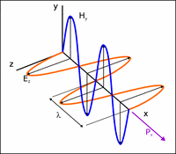

Optical versus Electrical Signals
Fields not conservative
No voltages and currents
Modulated carrier - envelope
  Carry phase information (Mag/Phase or Real/Imag)
  Interference effects
  Bi-directionality
Envelope representation
Forward signal
Courtesy: York

Slide 16
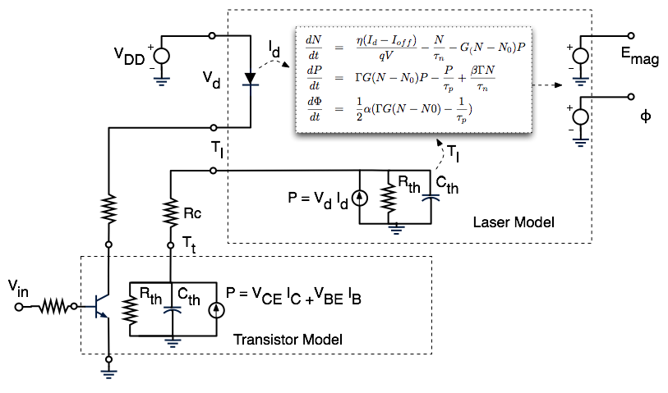
Compact models: Laser

Slide 17
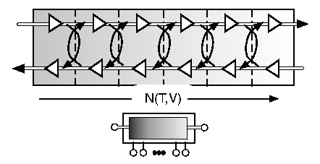
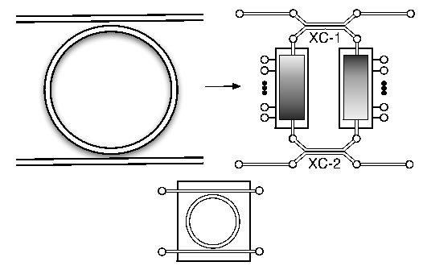
Other models: Distributed filter and Ring oscillator
Ring Oscillator
        Distributed filter -- n(x)

Slide 18
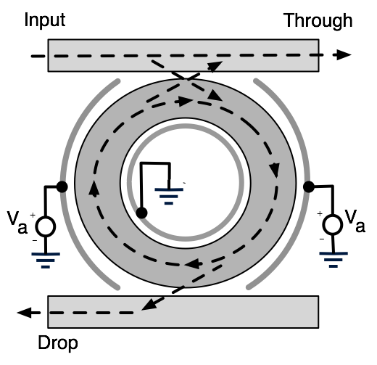
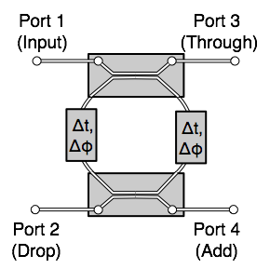
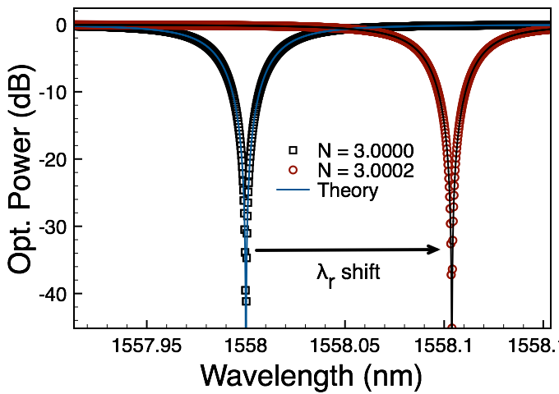
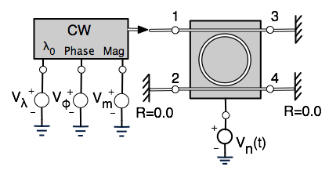
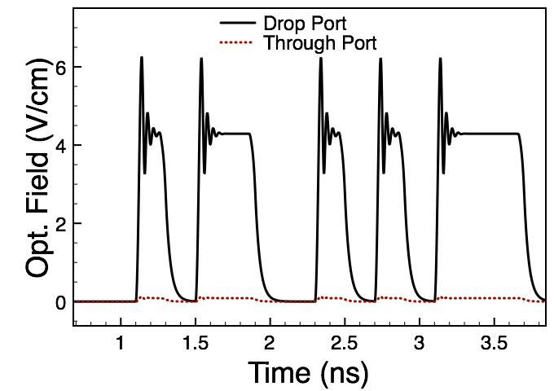
Ring oscillator and two example circuits

Slide 19
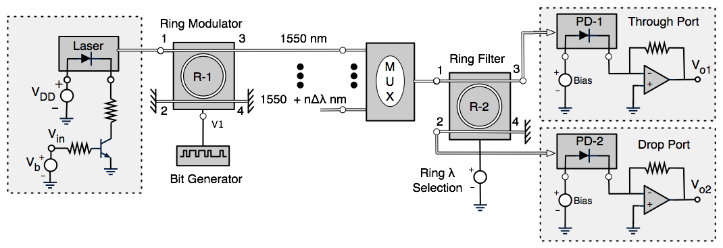
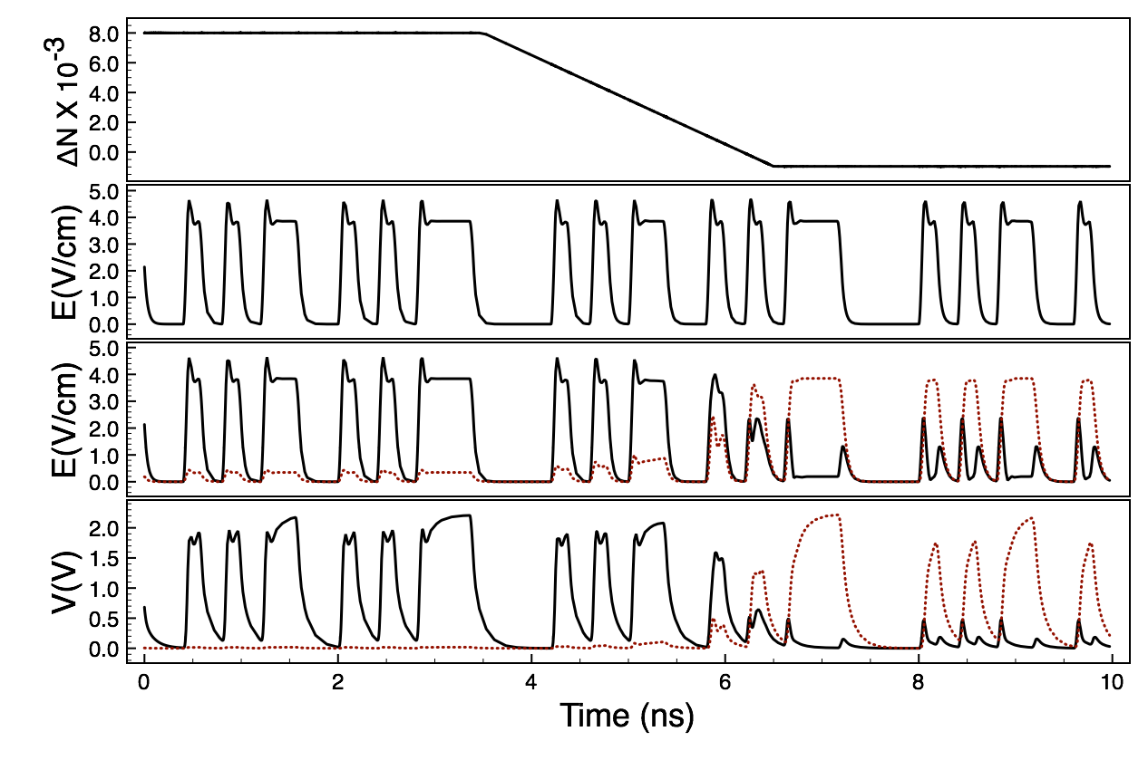
WDM – Ring switching circuit

Slide 20
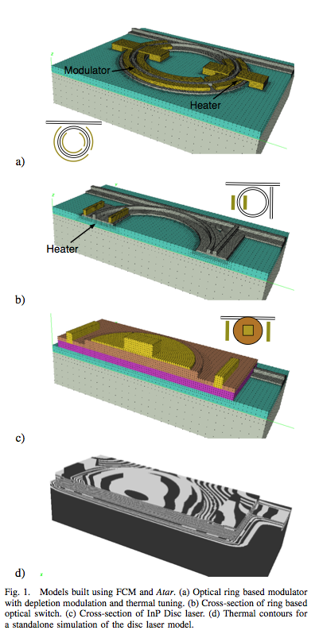

Putting it all together: Simulation of Integrated Optics
Three detailed models
  Disc based laser
  Ring modulator (PN diode modulation)
  Ring switch (thermal switching)
Each model built separately.
Thermal model from Atar describe by:

Slide 21
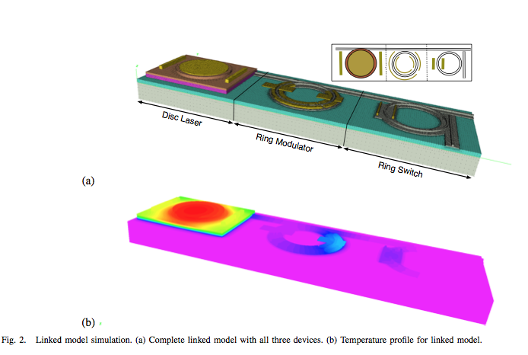
Linked thermal model
Link all three models using Atar.
Solve for reduced temperatures
Use Q to obtain real temperatures
Hot laser “bleeds” temperature along metal wires to ring.
Screws up design
Hiring !

Slide 22
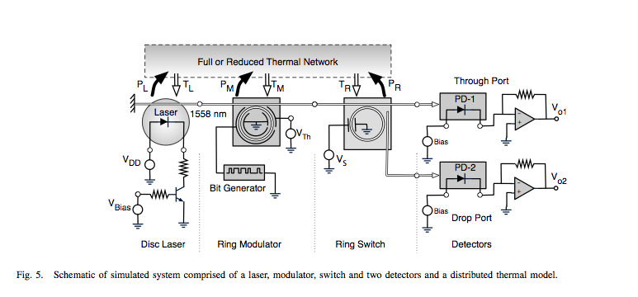
Put it all together in OptiSPICE
The reduced thermal model can be linked into an OptiSpice simulation (simply a stamp).

Slide 23
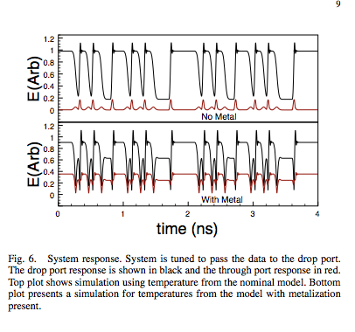
Coupled Simulations
Comparison of modulator operation for the two metal configurations.

Slide 24
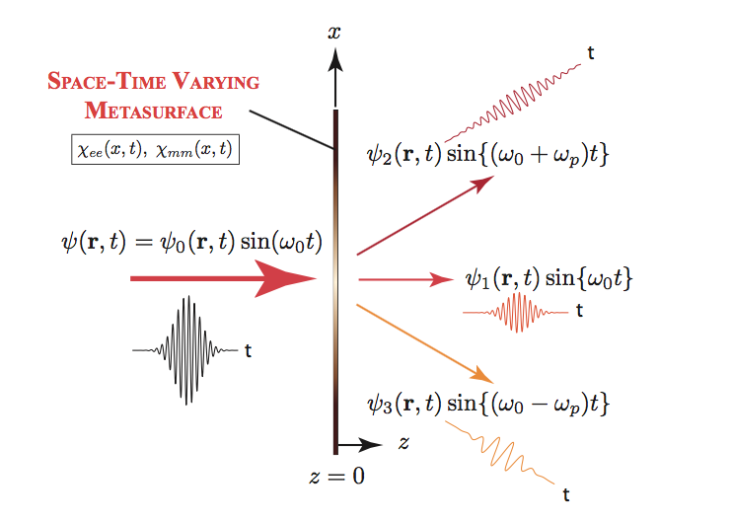
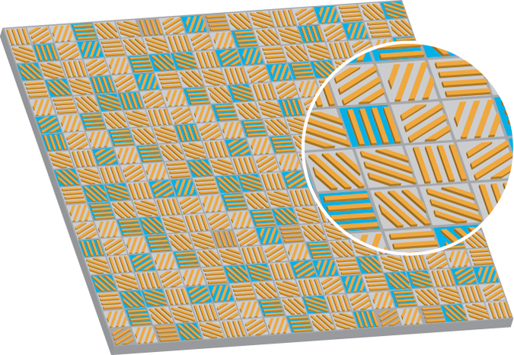
Meta- surface modeling
Work with Dr. Gupta.
Fundamental EM modeling
Array of structures (sub wavelength in size)
Possibly time-varying material properties
Many applications
  Frequency dependent propagation
  Cloaking!

Slide 25
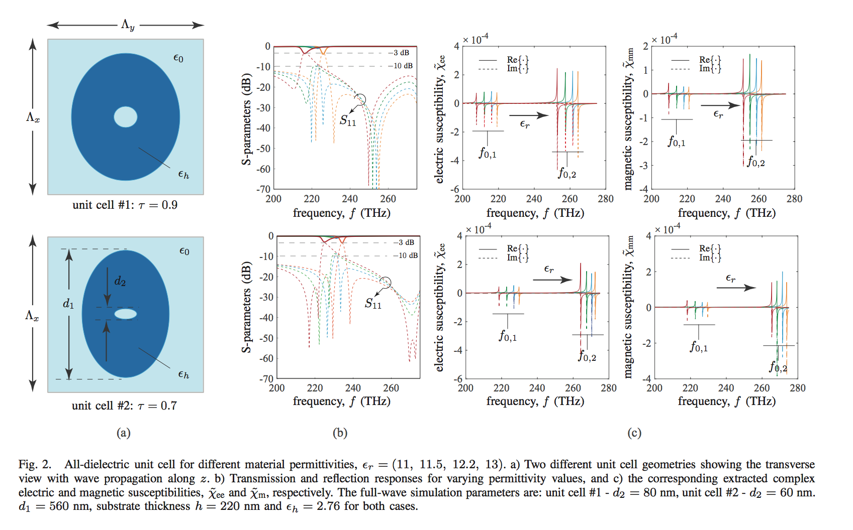
Meta- surface modeling
Unit cell modeling
HFSS / semi-analytic models
Design for a particular response
Optical or microwave
Time varying material properties
Use in surface model

Slide 26
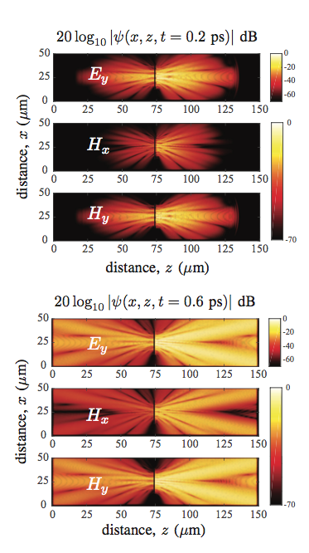
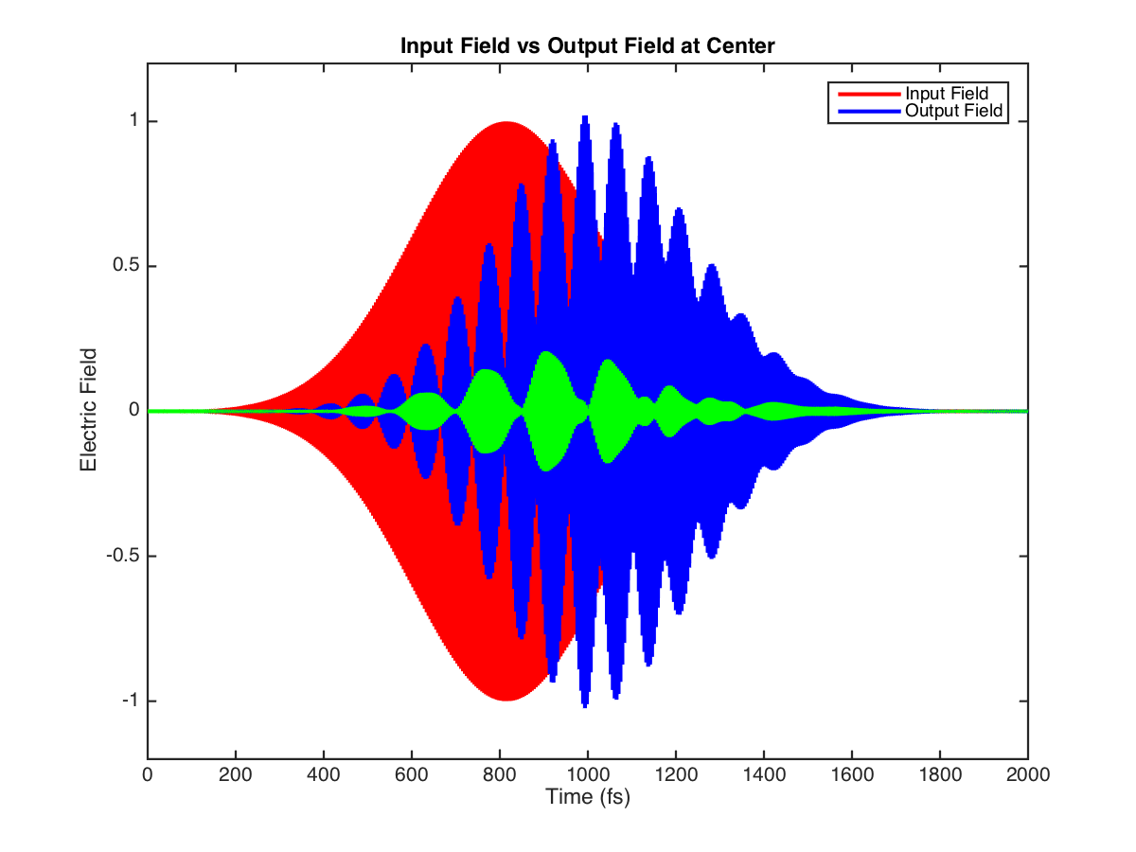
Meta- surface modeling
Surface response is prescribed by Maxwell’s Eq. and material response
Propagation to and from surface (Full wave EM modeling)

Slide 27
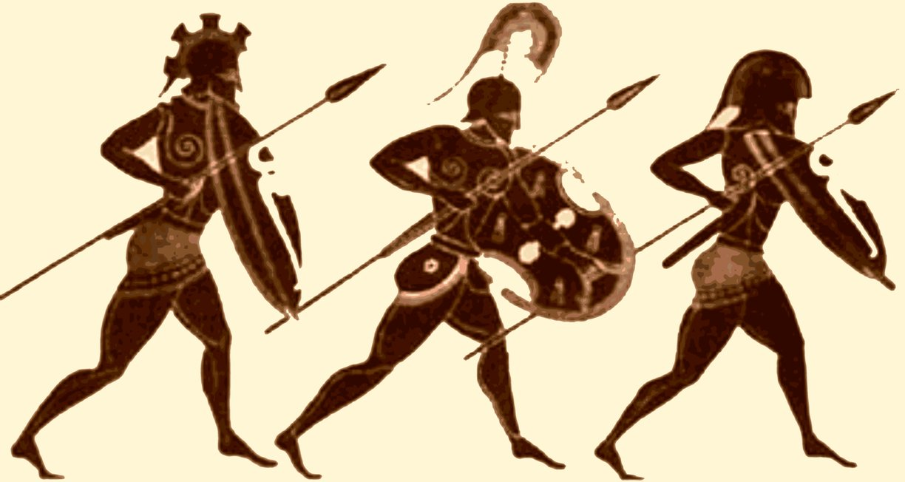
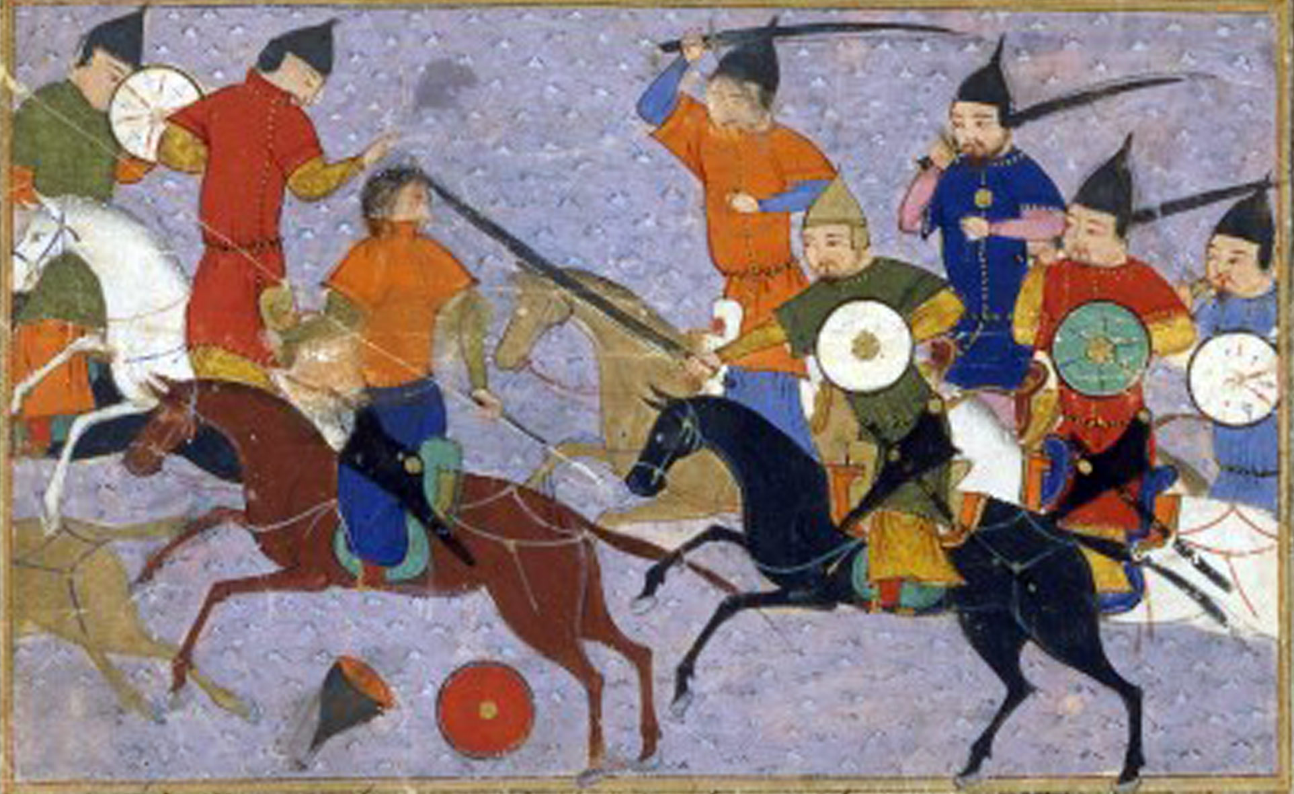
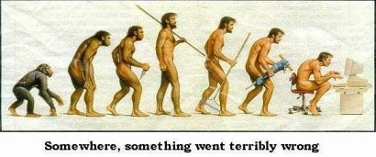
More about me
What else do I do?
  Workout (as much as my aging body allows)
    No more squash (the older I get the better I was)
    Swim, Run, yoga, weights,
    etc
  Read/Listen
    History
    Philosophy
    Evolution
    Brain science/psychology

Slide 28
Latest Exciting Stuff
Predictive coding (processing) models suggest that the brain is constantly generating and updating hypotheses that predict sensory input at varying levels of abstraction. This framework is in contrast to more mainstream views of the brain as integrating exteroceptive information through a predominantly feedforward process, with feedback connections playing a more minor role in cortical processing.

Slide 29
Even more …
No car I walk everywhere
No social media
Vegetarian
Politics – libertarian but not insane
Climate science – not convinced
TV – European Crime stuff (UK/Scandinavian)
Music – (Stuff from my youth (punk), African, reggae, blues, folk)
Ok that’s enough about me.

