Slide 1
Matlab plotting and Latex document creation

Slide 2
Overview
Matlab plotting
  2D
  3D
  Making it look good
Latex
  What it is and what it does
  How it works
  Overleaf
  Examples
  Demo

Slide 3
Matlab plotting (or using matplotlib in Python)
Creating simple 2D and 3D plots is very easy
A great deal of flexibility
With some effort you can make them look quite nice – although I use other packages to make higher quality figures.
High quality documents get good marks, good jobs and make you look good.
Very useful for debugging. Stop the program and look at things by plotting them.
Code available at: https://github.com/tjssmy/EcorMatlab/tree/master

Slide 4
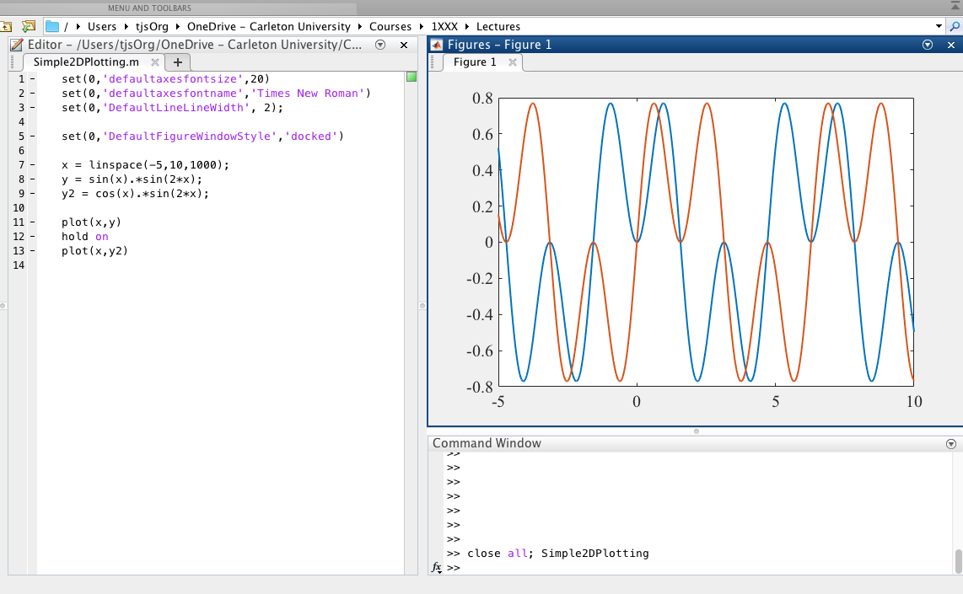
2D plotting – plot(x,y)
Plot(x,y) -- basic 2D plotting function
hold on – tells the plot to plot data on top of last data
hold off – tells the plot to only plot the new data
Linspace() – generates an array of linearly spaced points

Slide 5
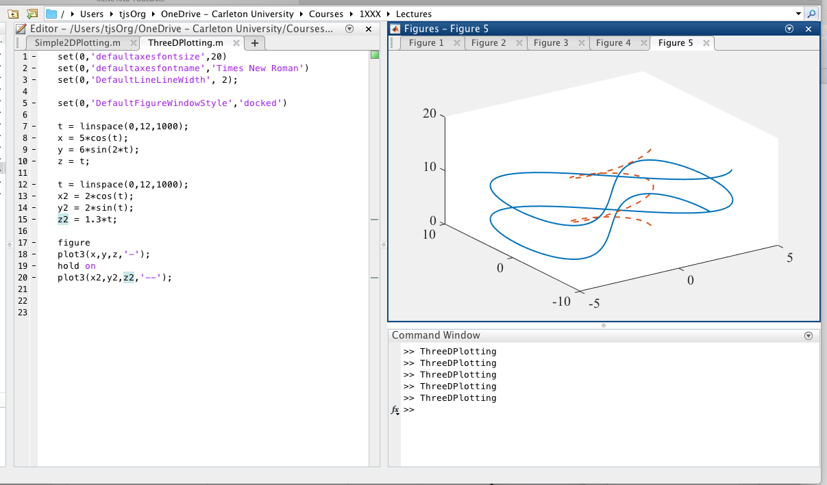
3D line plotting – plot3(x,y,z)
Plot3(x,y,z) -- basic 3D plotting function for points and lines.

Slide 6
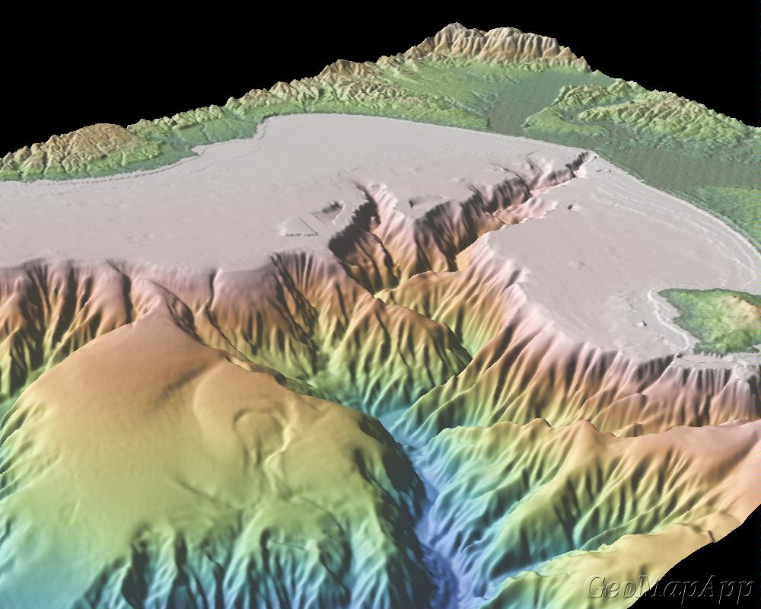
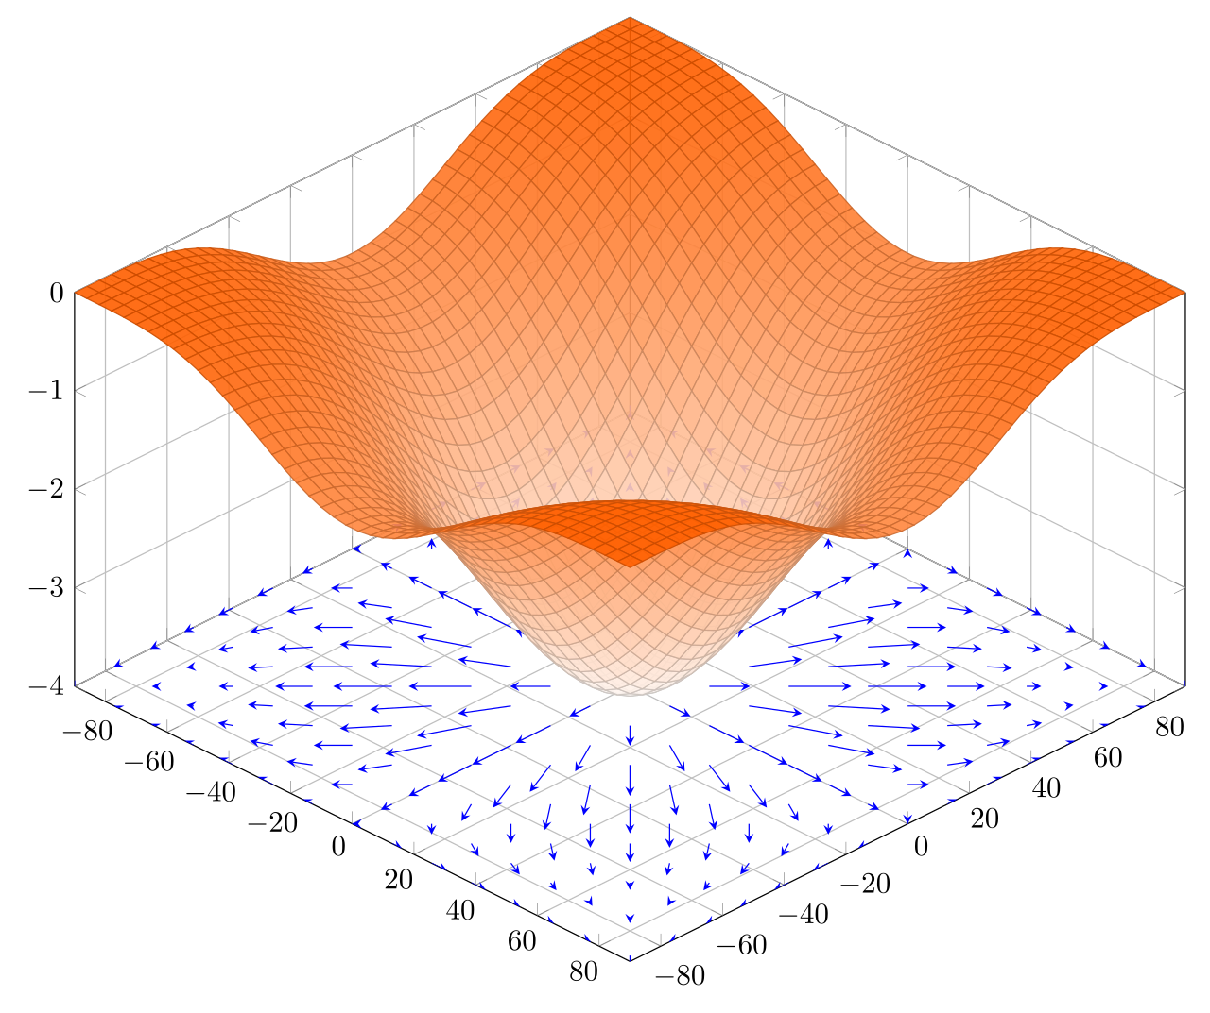
3D surfaces plotting and vectors
Surfaces z(x,y)
  Use color to represent height
  Shading? Ray tracing
Vectors
  Magnitude and direction
  Gradient is the slope of a surface.
  Plot as a vector field
This is a big deal
  Data (big data) visualization is very important to get right.

Slide 7
A bit of math: matrices and vectors - example of a data-structure
Vector and matrices are collection of numbers.
Arranged in a grid
We define mathematical operations on them
Very useful!
Row vector (3x1)
Row vector
Column vector (1X3)
Matrix (2X3)

Slide 8
Matrix as a data structure
Often we want to depict a surface h(x,y).
  Height, potential, etc
To do this we descritize:
  h(x,y) -> h(i,j)
  i and j are integers
h becomes a matrix!
Images are matrices (pixels)
  Three color matrices
    Red, Green, Blue

Slide 9
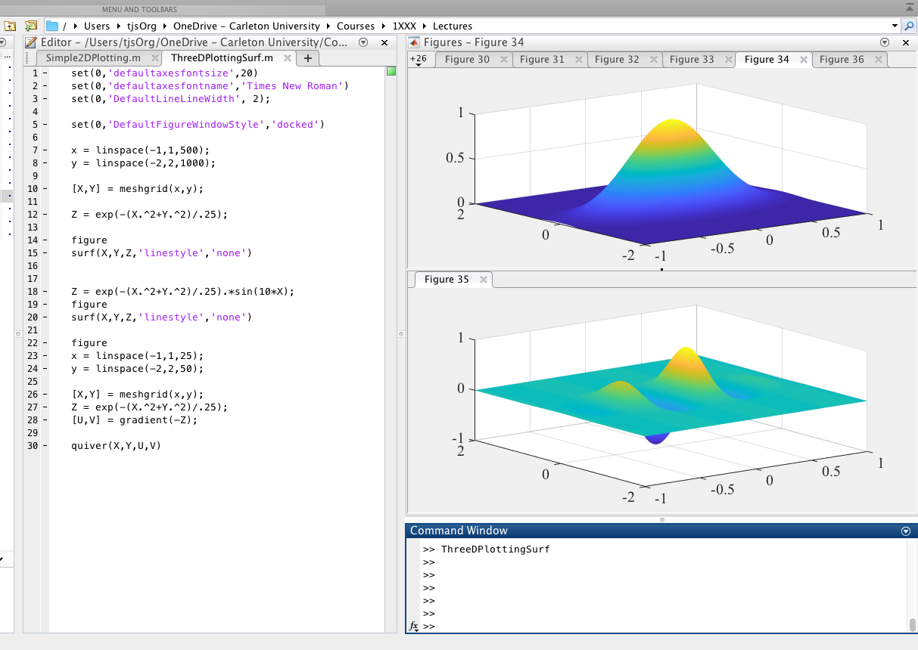
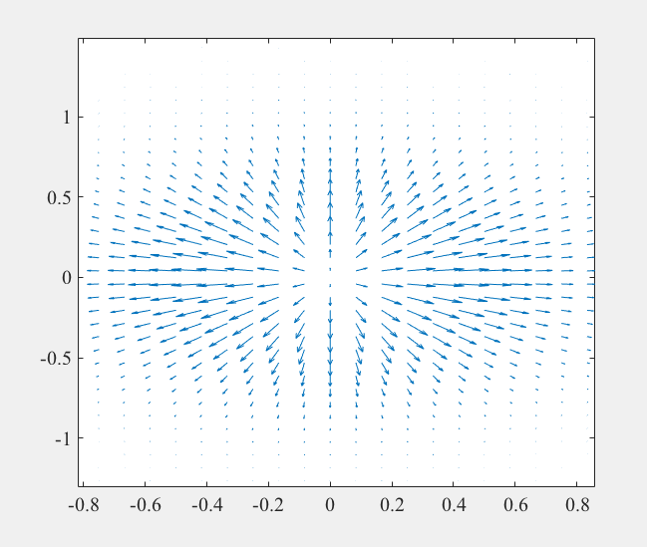
3D surface plotting – surf(x,y,z), quiver(x,y,u,v)
surf(x,y,z) – basic surface plotting function
meshgrid(x,y) -- generates 2D matrix of points
Quiver(x,y,uv) – plots a vector map

Slide 10
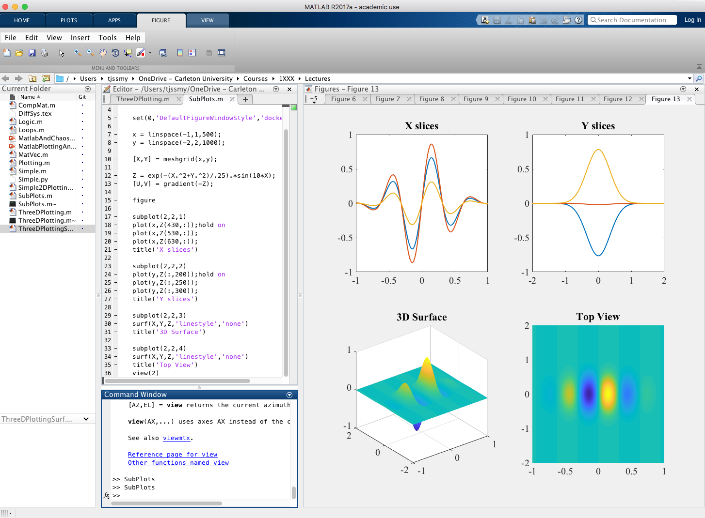
Subplots – multiple plots in one figure
Command Subplot(n,m,c)
  Creates a matrix of plots (nxm)
  c is the plot number number from left to right top to bottom.

Slide 11
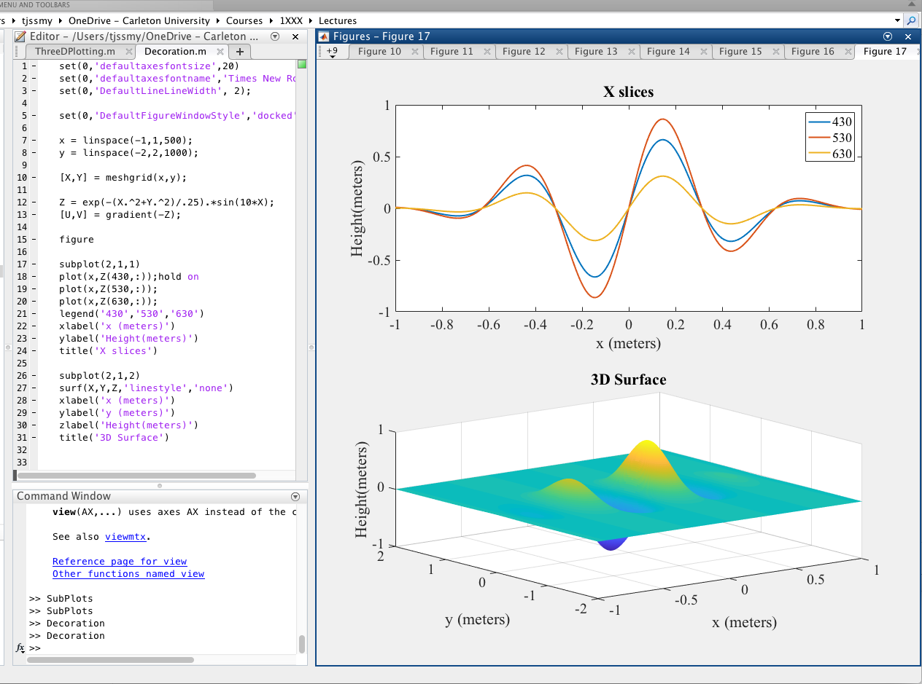
Decoration
Axis labels –
  xlabel()
  ylabel()
Titles – title()
Legends – legend()

Slide 12
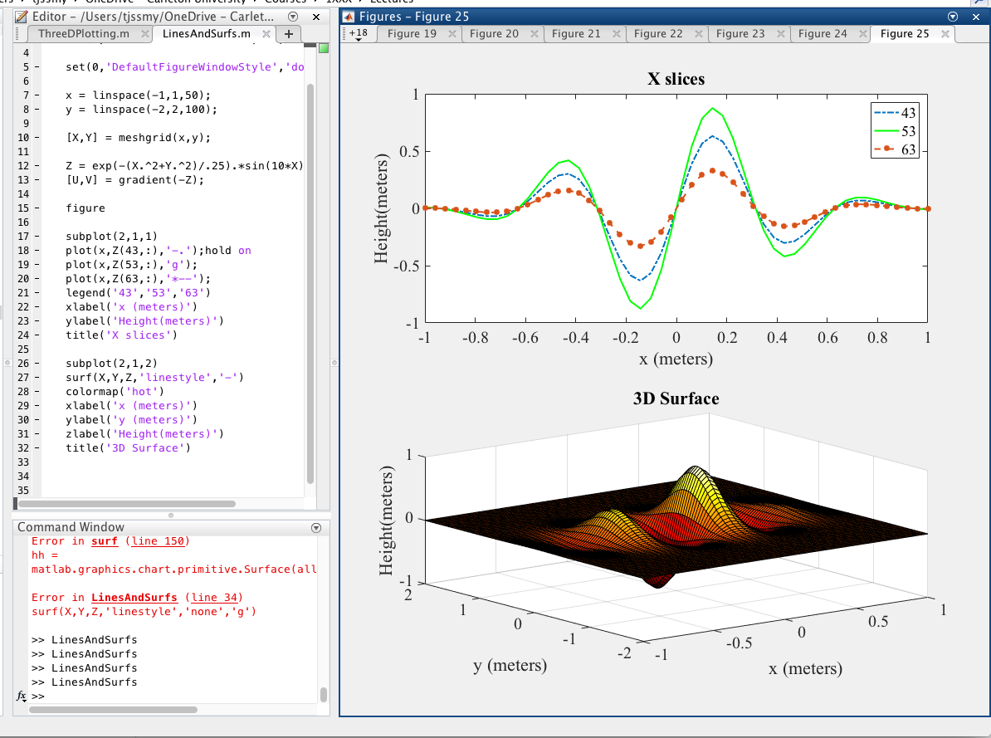
Control over how it looks
Add plot parameters in function calls:
  Line style – ‘—’, ‘-.’, etc.
  Color – ‘g’, ’r’, etc.
  Point style – ‘*’,’0’,’X’, etc.
Add surf parameters:
  Linestyle – ‘none’, ‘-’
Colormap fct. -- choose color scheme ‘hot’, etc.

Slide 13
Generating images for documents
Can save figures in matlab .fig format
Can edit using IDE
Export in many formats – png, jpeg, pdf, eps, etc.
In general vector graphics pdf, eps is better, but …
  Some issues (at least for me) with bounding box and cropping for pdf
Can be scripted into program i.e. save all figures and generate png’s.
In general script as much as possible to save time.

Slide 14
Latex
And documents

Slide 15
Latex and how you should create scientific documents
Creating complex and compatible documents with references and correct styling is cumbersome with Word
Latex is built on tex (a very low level page description language)
Intended for typesetting books and articles
Very nice looking
Optimized for scientific and engineering
Free source
Cross platform

Slide 16
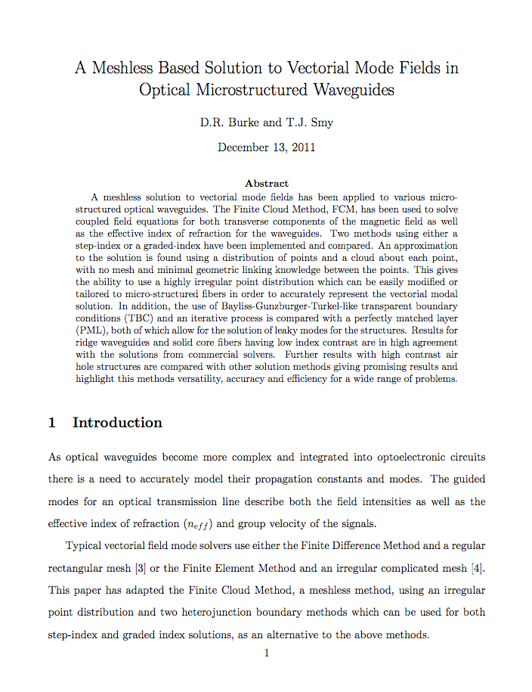
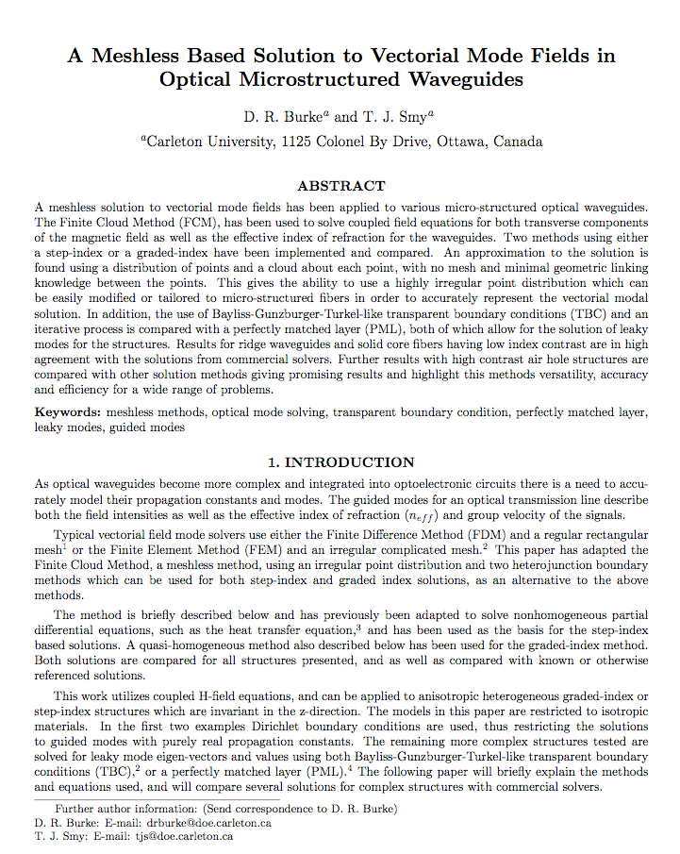
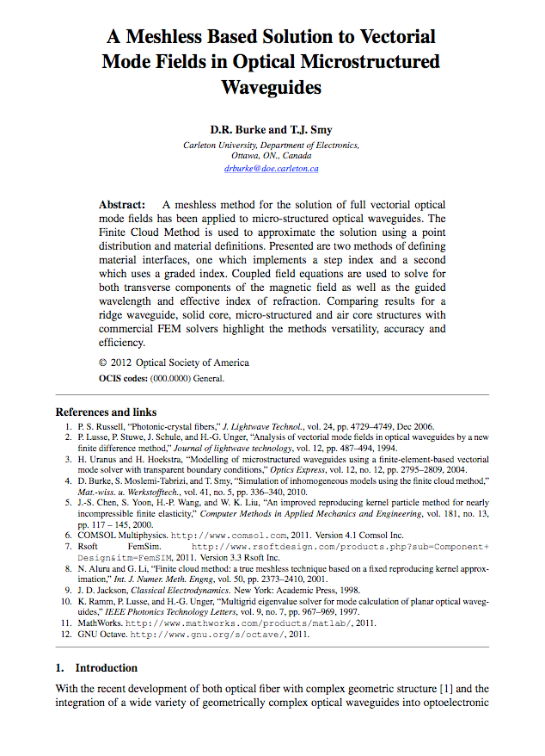
There exist alternatives to Word, one example is LaTeX - a typesetting language similar to HTML
Document Style sets the format

Slide 17
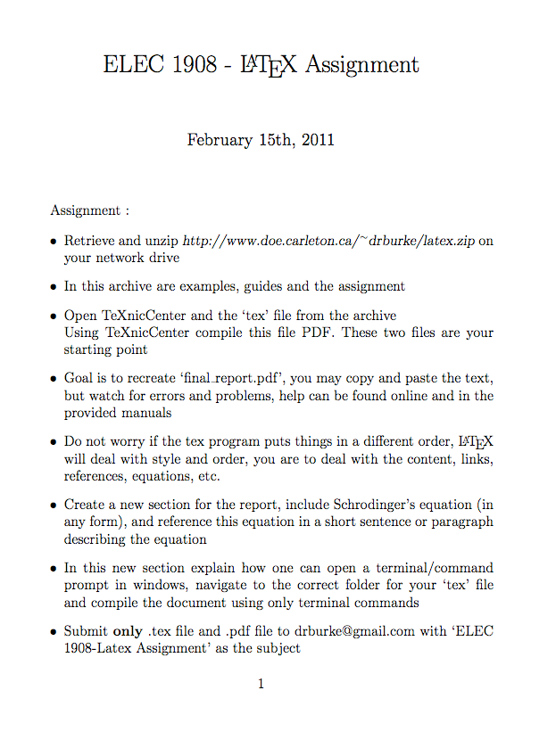
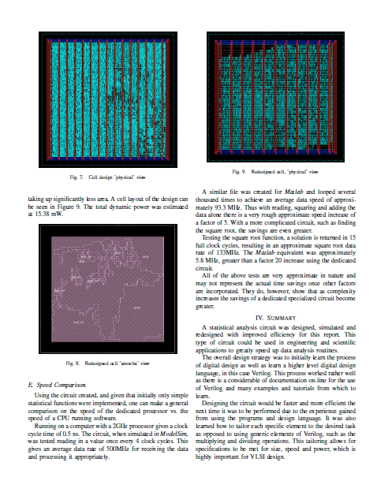
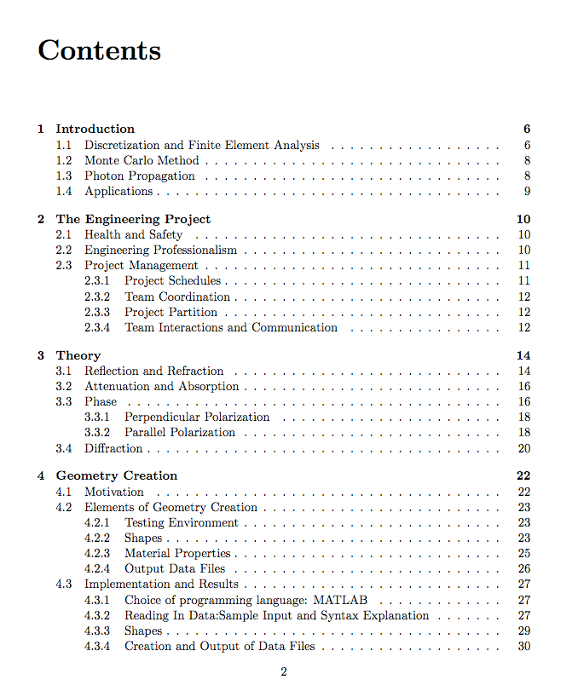
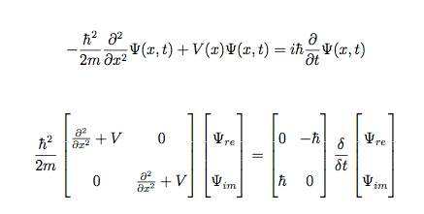
LaTeX can be used for papers, labs, word documents, assignments, presentations

Slide 18
LaTeX is written in code similar to HTML, then compiled like a ‘C’ or Python program into pdf
\documentclass[12pt]{article}%
\usepackage{amsmath}%
\usepackage{amsfonts}%
\usepackage{amssymb}%
\usepackage{graphicx}
\usepackage{setspace}
\usepackage{cite}
\usepackage{hyperref}
%-------------------------------------------
\begin{document}
\title{}
\author{Dan
\\ \emph{with} }
\date{\today}
\maketitle
\singlespacing
\begin{abstract}
\end{abstract}
\doublespacing
\section{Theory}
file.out
file.aux
file.log
file.pdf
compile

Slide 19
How to do it?
Install on your computer and run it locally
  Need tex, latex, editor, possible IDE, and pdf viewer
  Can be a bit of pain
  Local! So independent of Internet
  Cross platform (osx, windows, linux)
Use Overleaf
  Cloud based and browser based
  Free account – for minimal shared development
  Very easy
  Lots of online documentation
  Archiving and other features

Slide 20
Overleaf
Web and Browser based latex editor
Cloud based storage
Large number of templates
Collaborative document development
https://www.overleaf.com/
Takes away a LOT of the pain!

Slide 21


Slide 22
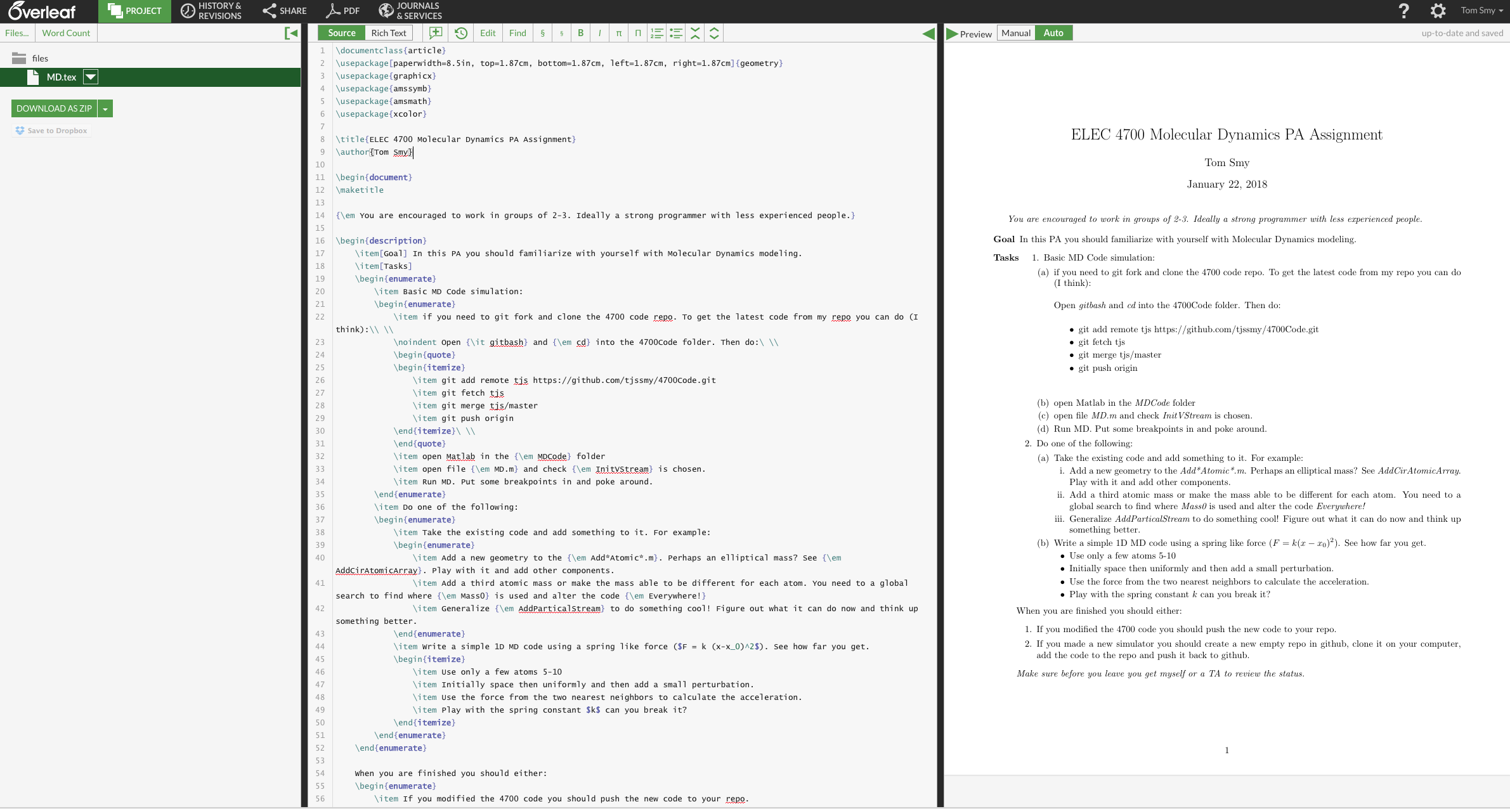

Slide 23

Templates

Slide 24
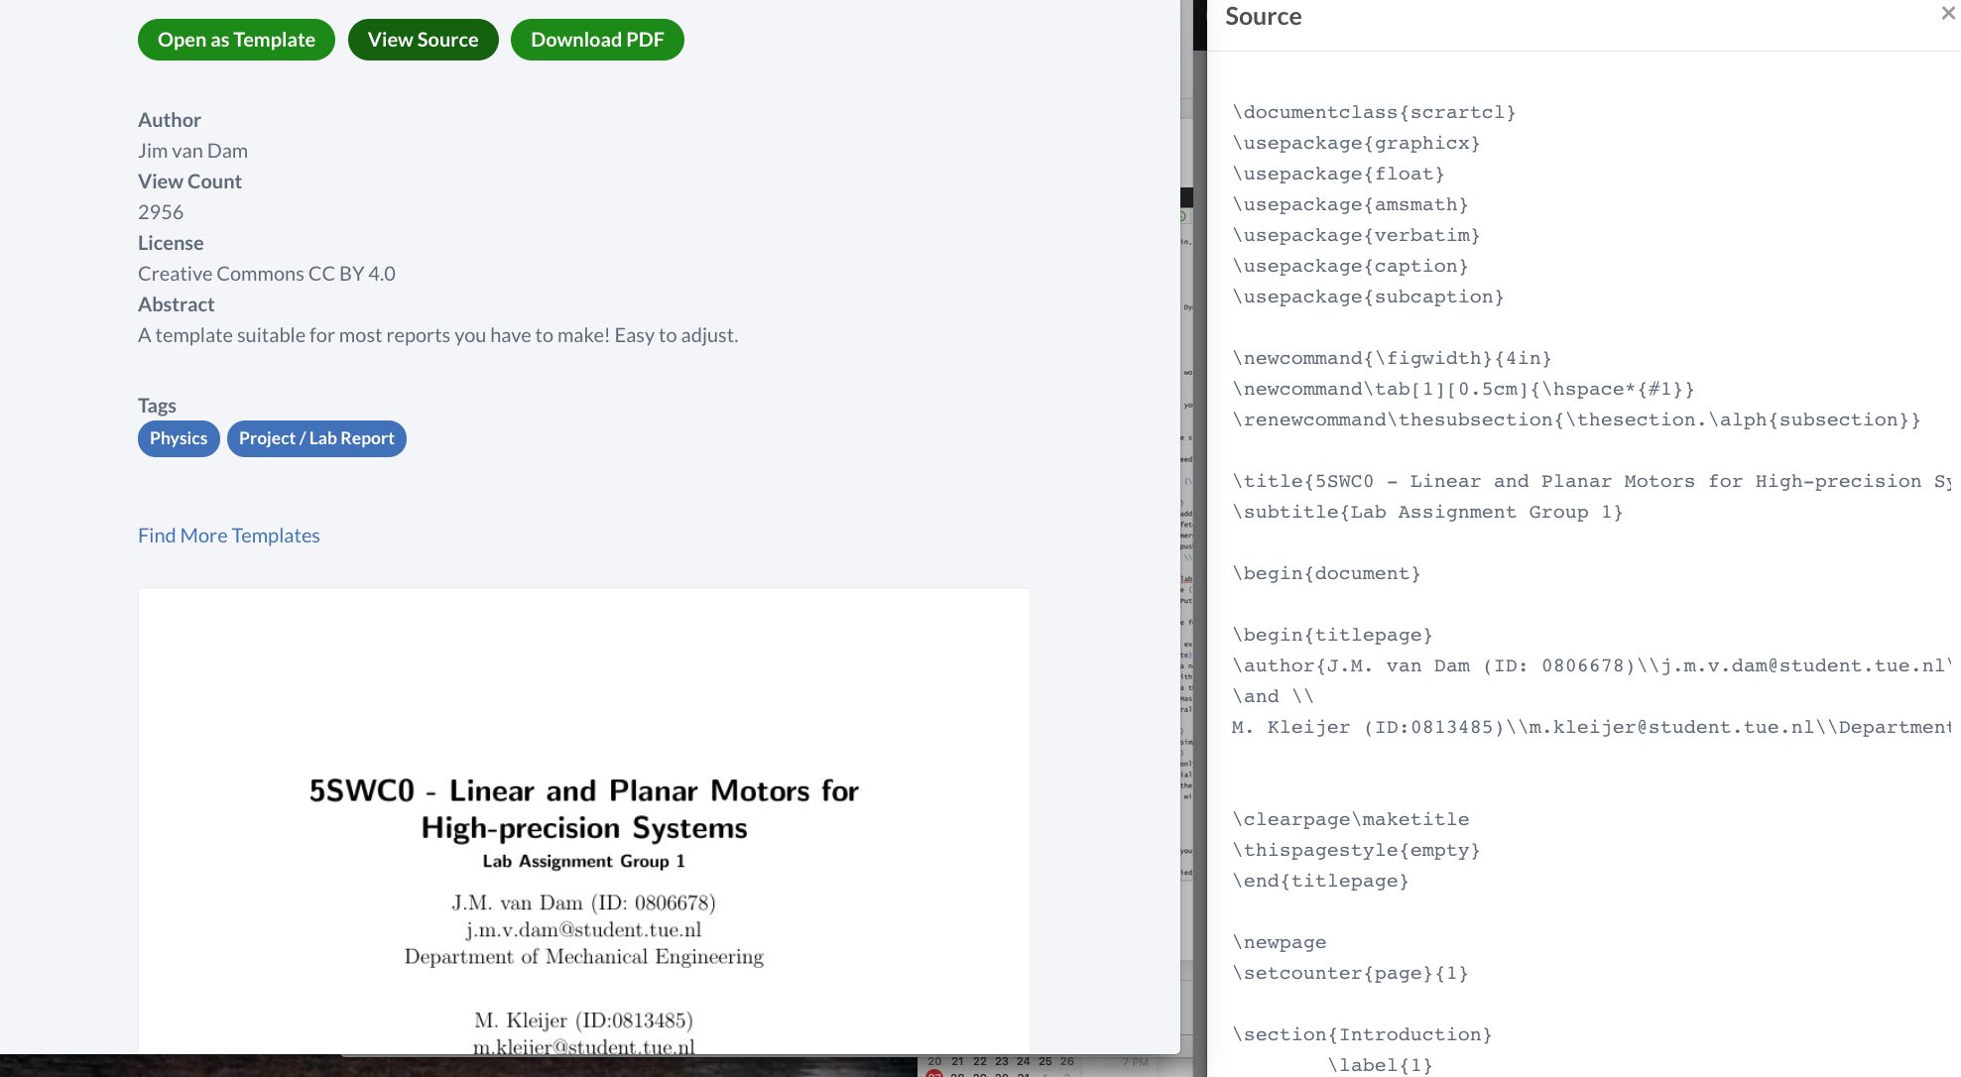

Slide 25
On your own Computer?
Get it from the web and install
Any text editor can be used
Compile:
  Command prompt
  IDE (integrated development environment) – quite a few on different platforms

Slide 26
Latex: Creating the document
Text Editors to edit and compile in shell/terminal
Integrated Design Environment (IDE) edit and compile in one application
Browser/cloud based tools (Overleaf)
On Mac you can use LatexIt to create equations for importing into powerpoint.
What you see is what you get (WYSIWYG) IDE’s.
  Attempt to recreate Word like experience
  Point and click latex editors
  Do not create nice latex
  BAD! Well I think so.

Slide 27
Text Editors – many choices
Cross Platform – Sublime Text (install latex mode then almost like an ide)
OSX – TextMate, Emacs, vi
Linux – Emacs, vi, vim.
Windows – Notepad++

Slide 28
WHERE CAN I FIND IT ?
Linux – check documentation for the Latex source
(suggested IDE: Kile)
Mac OS X – use MacTeX, or homebrew or macports to install as a package (suggested IDE: TeXShop)
Windows – MikTex or ProTeXt
(suggested IDE: TexWorks or Texniccenter)
In the lab click on file and TexWorks should start up.
These suggestions could be stale – google a bit to find the latest.

Slide 29
Latex – how to use it

Slide 30
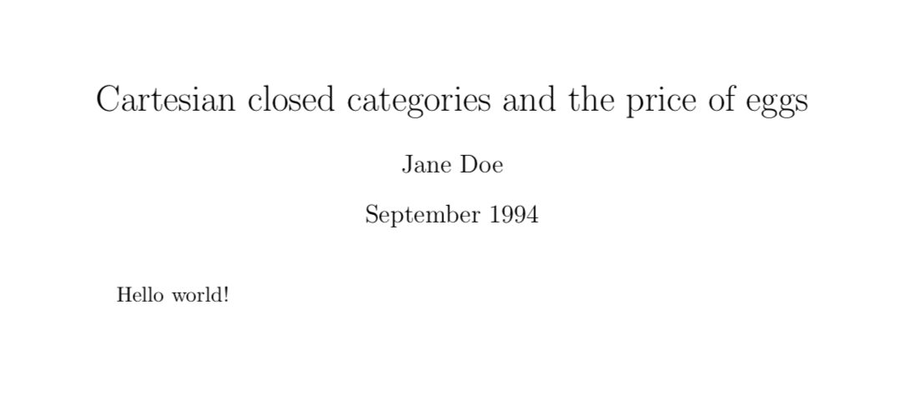
FILE STRUCTURE – for the input file (name.tex)
\documentclass{article}
\title{Cartesian closed categories and the price of eggs}
\author{Jane Doe}
\date{September 1994}
\begin{document}
\maketitle
Hello world!
\end{document}

Slide 31
PACKAGES ?
Add functionality to your documents
  Images
  Equations
  Links
  Etc.

Slide 32
PACKAGES
\usepackage{amsmath}%
\usepackage{amsfonts}%
\usepackage{amssymb}%
\usepackage{graphicx}
\usepackage{setspace}
\usepackage{cite}
\usepackage{hyperref}

Slide 33
NOTES ON LATEX
Commands and special characters
start with a ‘\’
Comments start with ‘%’,
New line ‘\newline’ or ‘\\’
Special characters or inline equations must be surrounded by ‘$’

Slide 34
NOTES ON LATEX
code | result
superscrip$^t$ | superscrip^{t}
$super^{script}$ | super^{script}
subscrip$_t$ | subscript
big $\Omega$ | big Ω
little $\omega$ | little ω

Slide 35
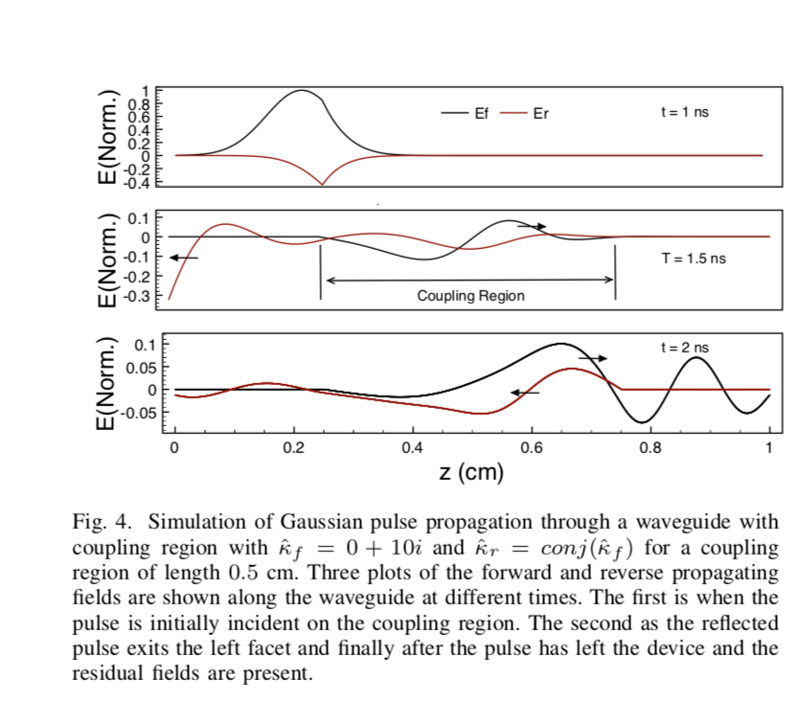
GRAPHICS / FIGURES
Including a figure:
\begin{figure}[htbp] %[Here Top Bottom Page(of floats)]
\centering %center the Figure
\includegraphics[width=3.0in]{HeNeSetup} %Width and Filename
\caption{Diagram of equipment setup used for the HeNe laser test experiments} %Caption for the figure
\label{fg:lasertest} %Label name for the figure, use this to reference it later.
\end{figure}
Figures can be of type .jpg, .eps, pdf and .png
some others but may need extra packages…
Label must come after caption

Slide 36
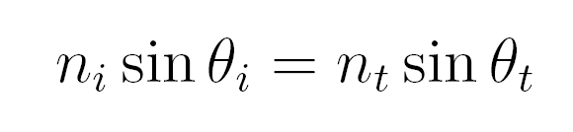

EQUATIONS
Including an Equation:
\begin{align}
n_i \sin \theta _i = n_t \sin \theta _t \label{eq:snell}
\end{align}
Gives (with a reference number)…

Slide 37
TABLES
The code looks complicated
End result looks very nice
Very customizable once you know the right commands

Slide 38
TABLES
\begin{table}[htbp]
\centering
\begin{tabular}{||l|cr|}
\hline
col 1 & col 2 & col 3 \\
\hline
\hline
1 & 3 & 5 \\
a & bdh & this \\
\hline
\end{tabular}
\caption{Table Caption}
\label{tab:table_label}
\end{table}

Slide 39
CITATIONS & REFERENCES
At any point in a paper one can include a citation or reference
code | result
Snell’s law\cite{snell} is shown in equation \eqref{eq:snellslaw}. | Snell’s law[1] is shown in equation (2).

Slide 40
BIBLIOGRAPHY AND REFERENCES
Bibliography is at the end and must include everything that has a \cite{} in the paper
References must point to a “\label” somewhere in the document
Chapter, table, figure, equation, etc.

Slide 41
HOW TO COMPILE
Easiest to compile to PDF, but many other options are available
In Overleaf just a click away!
Locally it can be done from a program OR command line
>> pdflatex filename.tex
  Output is to “filename.pdf”

Slide 42
HOW TO COMPILE
References and citations are found at runtime and no searching is performed.
Needs to be compiled TWICE, once to see all references, second to label them appropriately
Overleaf handles all this for you.

Slide 43
Compiling the ‘tex’ file - program reads through your file ONCE
See equation \eqref{simpleMath}.
\begin{equation}
1+2=3 \label{simpleMath}
\end{equation}

Slide 44
Compiling the ‘tex’ file - program reads through your file ONCE
??
See equation \eqref{simpleMath}.
\begin{equation}
1+2=3 \label{simpleMath}
\end{equation}
1
file.aux
Adds ‘simpleMath’

Slide 45
Compiling the ‘tex’ file - program reads through your file ONCE
Found it !
See equation \eqref{simpleMath}.
\begin{equation}
1+2=3 \label{simpleMath}
\end{equation}
file.aux
2
Adds ‘simpleMath’

Slide 46
SOME TIPS
Use your old files as starting points for new reports
Search examples and guides for added help, lots of resources available (Overleaf Templates!)
Many programs can output to Latex format (ex. MathType, Maple, …)
Google is your friend – if you want to do it somebody else did to.

Slide 47
SOME TIPS
Use labels with useful names
  \label{fig:nucleus} Good !
  \label{pic2} Bad
  \label{fig:big_atom} Good !
  \label{fig:big atom} Bad
When in doubt, compile again

Slide 48
Overleaf and Latex Demo!

